Slide 1
Introduction to Classification
CSCI 347
Adiesha Liyana Ralalage

Slide 2
Classification
Class labels are always categorical
Input data matrix
New data instance
Weather | Weekend? | Finished HW | Go Hiking?
Snow | Yes | No | Yes
Overcast | No | No | No
Sunny | Yes | No | Yes
Overcast | Yes | Yes | Yes
Overcast | No | Yes | Yes
Snow | No | Yes | No
Overcast | Yes | No | No
Sunny | Yes | No | No
Sunny | No | Yes | Yes
Snow | No | Yes | Yes
Snow | Yes | No | No
Overcast | Yes | No | No
Overcast | No | Yes | Yes
Weather | Weekend? | Finished HW | Go Hiking?
Sunny | Yes | No | ?
Goal is to predict the class of the new data

Slide 3
Classification
Input is also commonly in the form:
New data instance
Weather | Weekend? | Finished HW | Target/Label/Class
Snow | Yes | No | Yes
Overcast | No | No | No
Sunny | Yes | No | Yes
Overcast | Yes | Yes | Yes
Overcast | No | Yes | Yes
Snow | No | Yes | No
Overcast | Yes | No | No
Sunny | Yes | No | No
Sunny | No | Yes | Yes
Snow | No | Yes | Yes
Snow | Yes | No | No
Overcast | Yes | No | No
Overcast | No | Yes | Yes
Weather | Weekend? | Finished HW | Target/Label/Class
Sunny | Yes | No | ?

Slide 4
Classification
Input is also commonly in the form:
New data instance
Weather | Weekend? | Finished HW
Snow | Yes | No
Overcast | No | No
Sunny | Yes | No
Overcast | Yes | Yes
Overcast | No | Yes
Snow | No | Yes
Overcast | Yes | No
Sunny | Yes | No
Sunny | No | Yes
Snow | No | Yes
Snow | Yes | No
Overcast | Yes | No
Overcast | No | Yes
y
Yes
No
Yes
Yes
Yes
No
No
No
Yes
Yes
No
No
Yes
Weather | Weekend? | Finished HW | y
Sunny | Yes | No | y=?

Slide 5
Introduction to Bayes classifier
CSCI 347

Slide 6
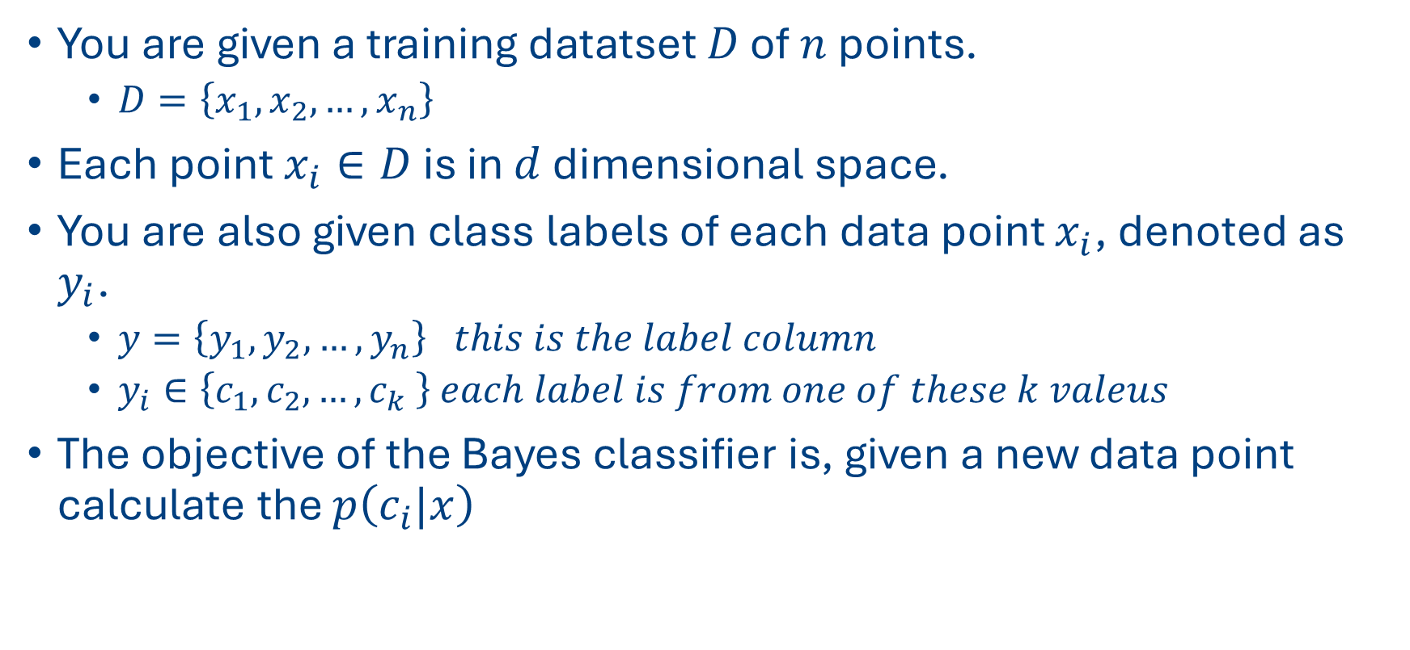
Bayes Classifier
You are given a training datatset $D$ of $n$ points.
$D=\left\{x_{1},x_{2},…, x_{n}\right\}$
Each point $x_{i}∈D$ is in $d$ dimensional space.
You are also given class labels of each data point $x_{i}$, denoted as $y_{i}$.
$y=\left\{y_{1},y_{2},…, y_{n}\right\} this is the label column$
$y_{i}∈\left\{c_{1}, c_{2},…,c_{k} \right\} each label is from one of these k valeus$
The objective of the Bayes classifier is, given a new data point calculate the $p\left(c_{i}|x\right)$

Slide 7
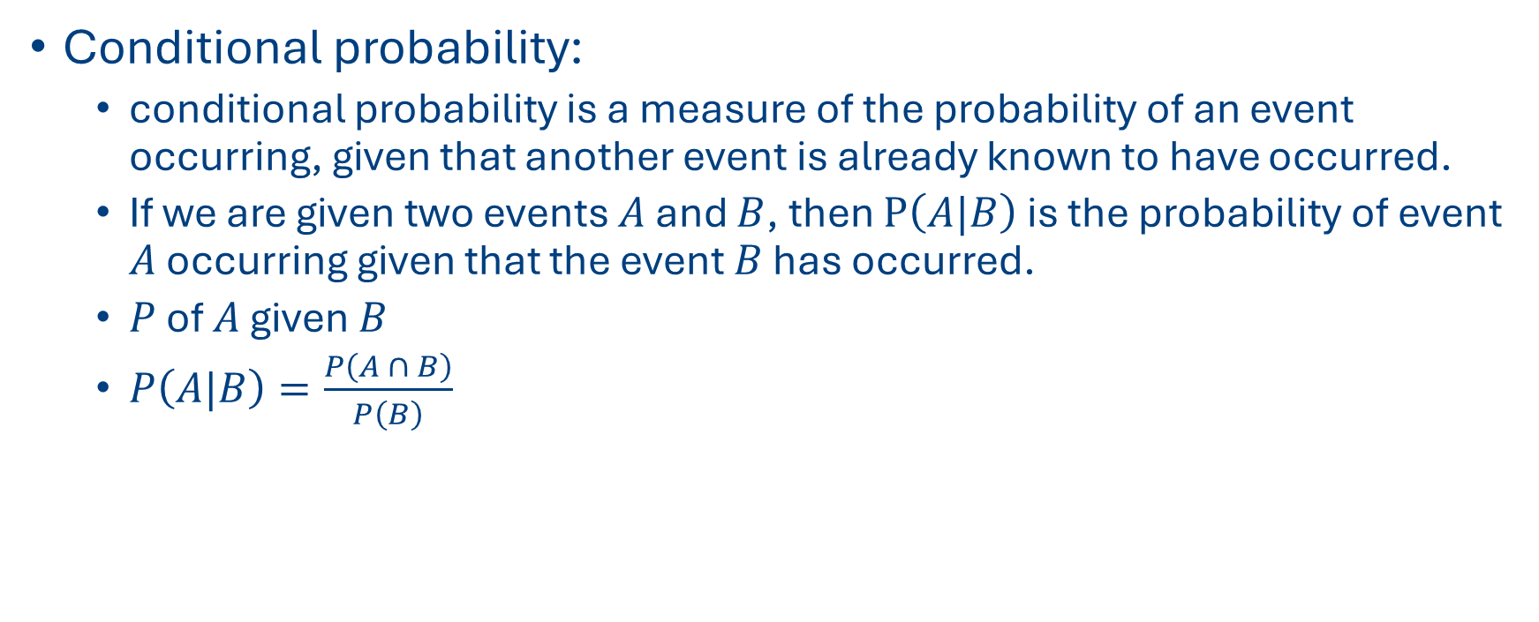
Let’s look at some basic probability theory
Conditional probability:
conditional probability is a measure of the probability of an event occurring, given that another event is already known to have occurred.
If we are given two events $A$ and $B$, then $P\left(A|B\right)$ is the probability of event $A$ occurring given that the event $B$ has occurred.
$P$ of $A$ given $B$
$P\left(A|B\right)=\frac{P\left(A ∩ B\right)}{P\left(B\right)}$

Slide 8
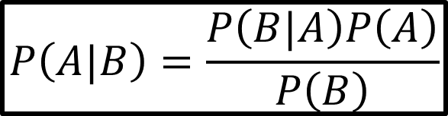
Bayes Theorem
Bayes theorem gives a mathematical rule for inverting conditional probabilities, allowing you to find the probability of a cause given effect.
$$P\left(A|B\right)=\frac{P\left(B|A\right)P\left(A\right)}{P\left(B\right)}$$

Slide 9
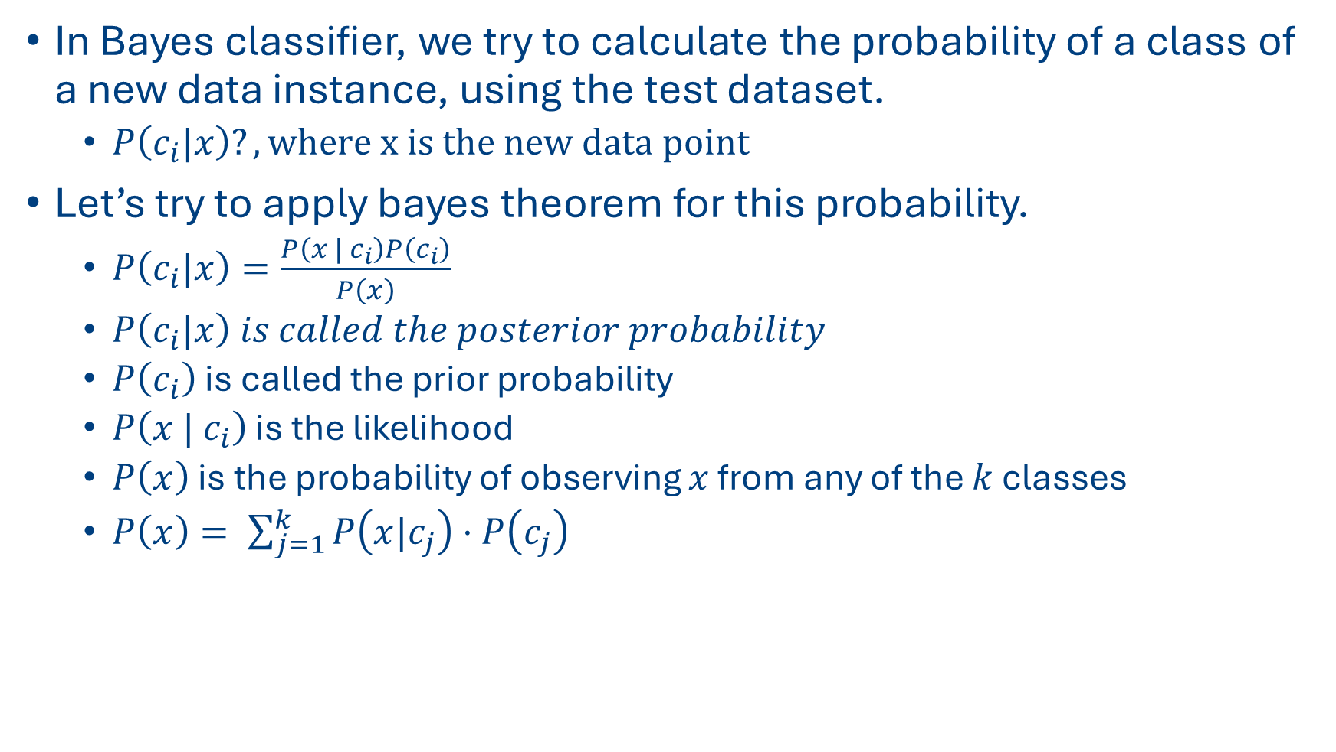
Bayes Theorem
In Bayes classifier, we try to calculate the probability of a class of a new data instance, using the test dataset.
$P\left(c_{i}|x\right)?, where x is the new data point$
Let’s try to apply bayes theorem for this probability.
$P\left(c_{i}|x\right)=\frac{P\left(x | c_{i}\right)P\left(c_{i}\right)}{P\left(x\right)}$
$P\left(c_{i}|x\right) is called the posterior probability$
$P\left(c_{i}\right)$ is called the prior probability
$P\left(x | c_{i}\right)$ is the likelihood
$P\left(x\right)$ is the probability of observing $x$ from any of the $k$ classes
$P\left(x\right)= \sum_{j=1}^{k}{P\left(x|c_{j}\right)⋅P\left(c_{j}\right)}$
Notes:
Posterior probability is the probability of an
initial belief before seeing evidence BBB event after taking into account new evidence or information.
how likely we are to observe B if A is true
the overall probability of observing BBB, considering all possible causes

Slide 10
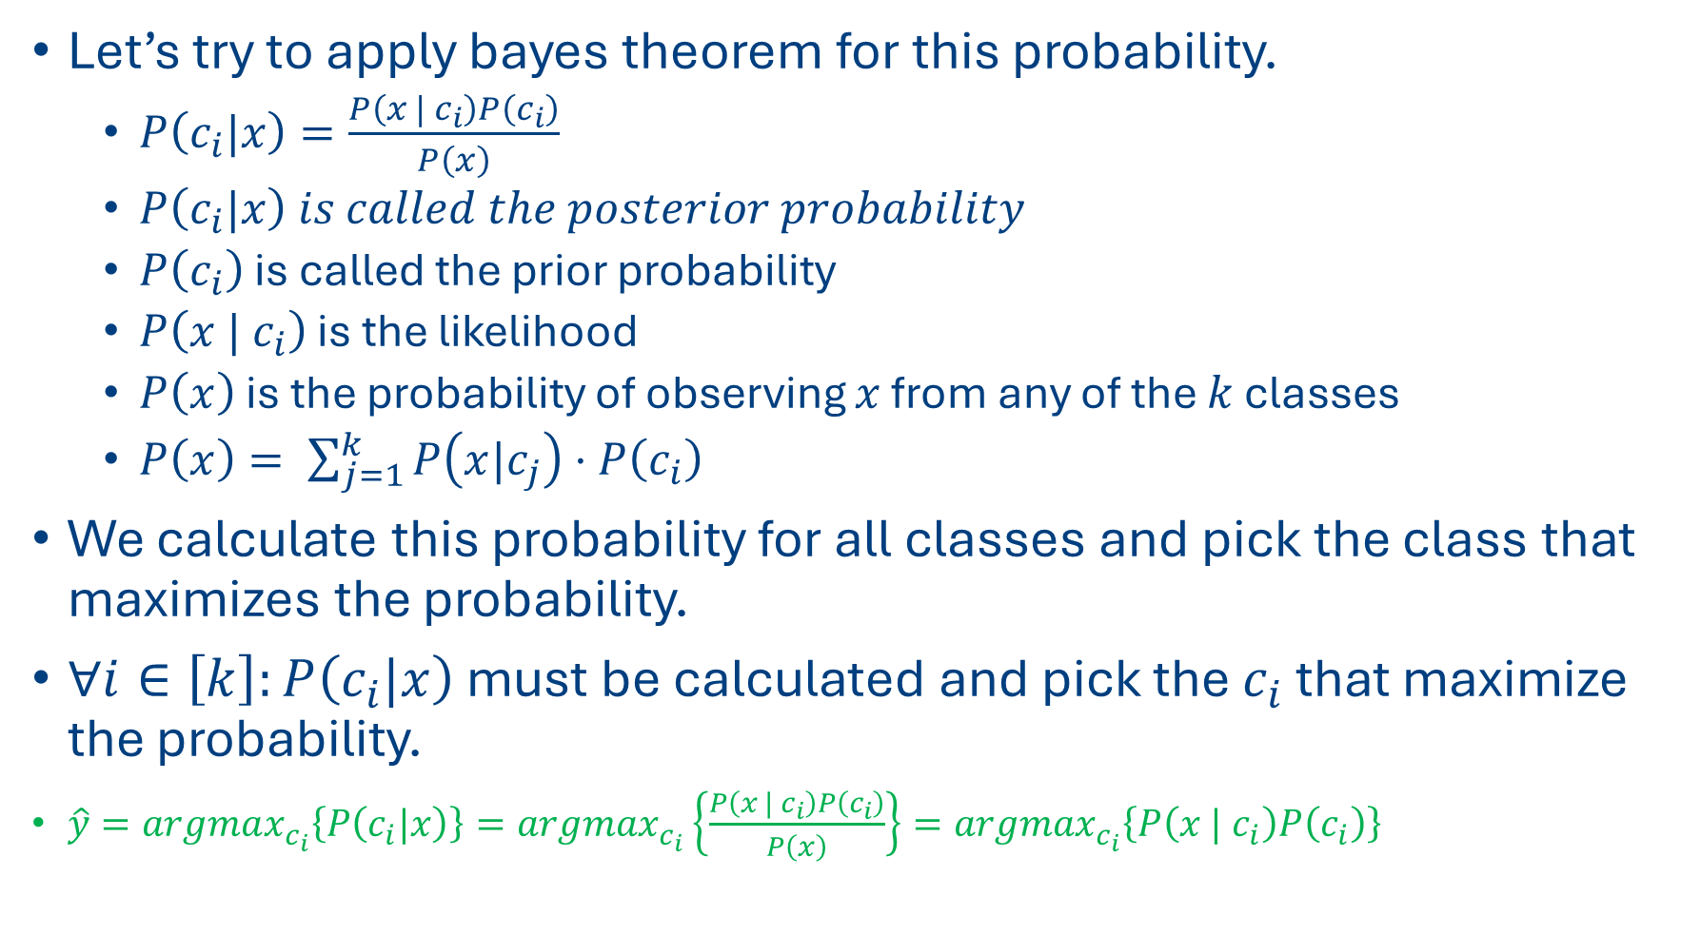
Bayes Theorem
Let’s try to apply bayes theorem for this probability.
$P\left(c_{i}|x\right)=\frac{P\left(x | c_{i}\right)P\left(c_{i}\right)}{P\left(x\right)}$
$P\left(c_{i}|x\right) is called the posterior probability$
$P\left(c_{i}\right)$ is called the prior probability
$P\left(x | c_{i}\right)$ is the likelihood
$P\left(x\right)$ is the probability of observing $x$ from any of the $k$ classes
$P\left(x\right)= \sum_{j=1}^{k}{P\left(x|c_{j}\right)⋅P\left(c_{i}\right)}$
We calculate this probability for all classes and pick the class that maximizes the probability.
$∀i∈\left[k\right]:P\left(c_{i}|x\right)$ must be calculated and pick the $c_{i}$ that maximize the probability.
$\hat{y}=argmax_{c_{i}}\left\{P\left(c_{i}|x\right)\right\}=argmax_{c_{i}}\left\{\frac{P\left(x | c_{i}\right)P\left(c_{i}\right)}{P\left(x\right)}\right\}=argmax_{c_{i}}\left\{P\left(x | c_{i}\right)P\left(c_{i}\right)\right\}$

Slide 11
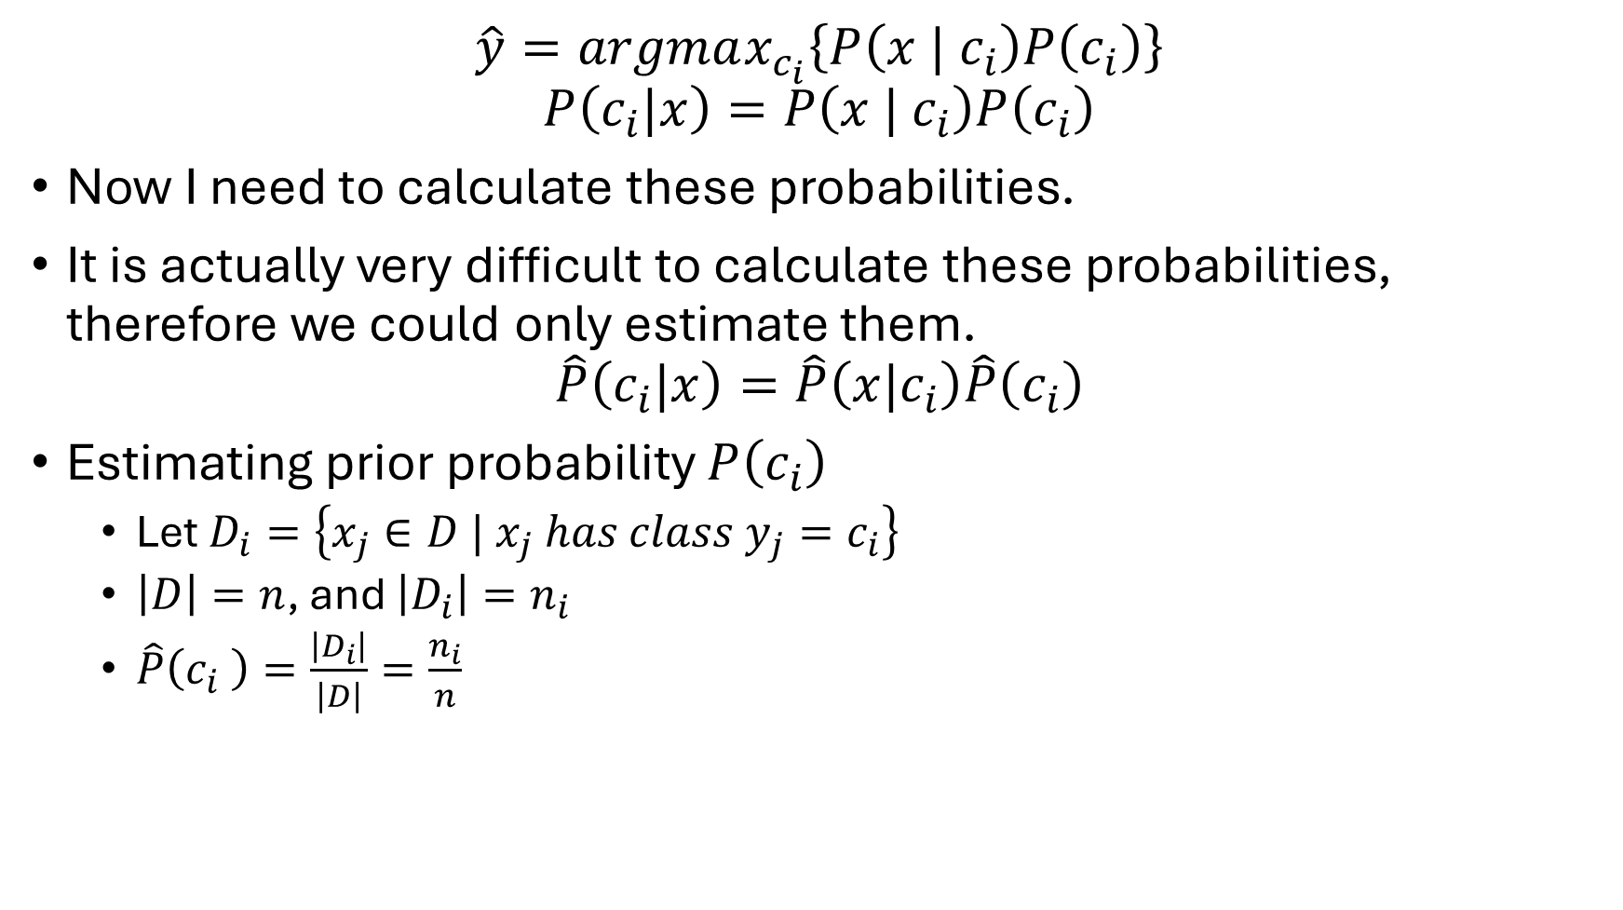
Bayes Theorem
$$\hat{y}=argmax_{c_{i}}\left\{P\left(x | c_{i}\right)P\left(c_{i}\right)\right\}$$
$$P\left(c_{i}|x\right)=P\left(x | c_{i}\right)P\left(c_{i}\right)$$
Now I need to calculate these probabilities.
It is actually very difficult to calculate these probabilities, therefore we could only estimate them.
$$\hat{P}\left(c_{i}|x\right)=\hat{P}\left(x|c_{i}\right)\hat{P}\left(c_{i}\right)$$
Estimating prior probability $P\left(c_{i}\right)$
Let $D_{i}=\left\{x_{j}∈D | x_{j} has class y_{j}=c_{i}\right\}$
$\left|D\right|=n$, and $\left|D_{i}\right|=n_{i}$
$\hat{P}\left(c_{i} \right)=\frac{\left|D_{i}\right|}{\left|D\right|}=\frac{n_{i}}{n}$

Slide 12
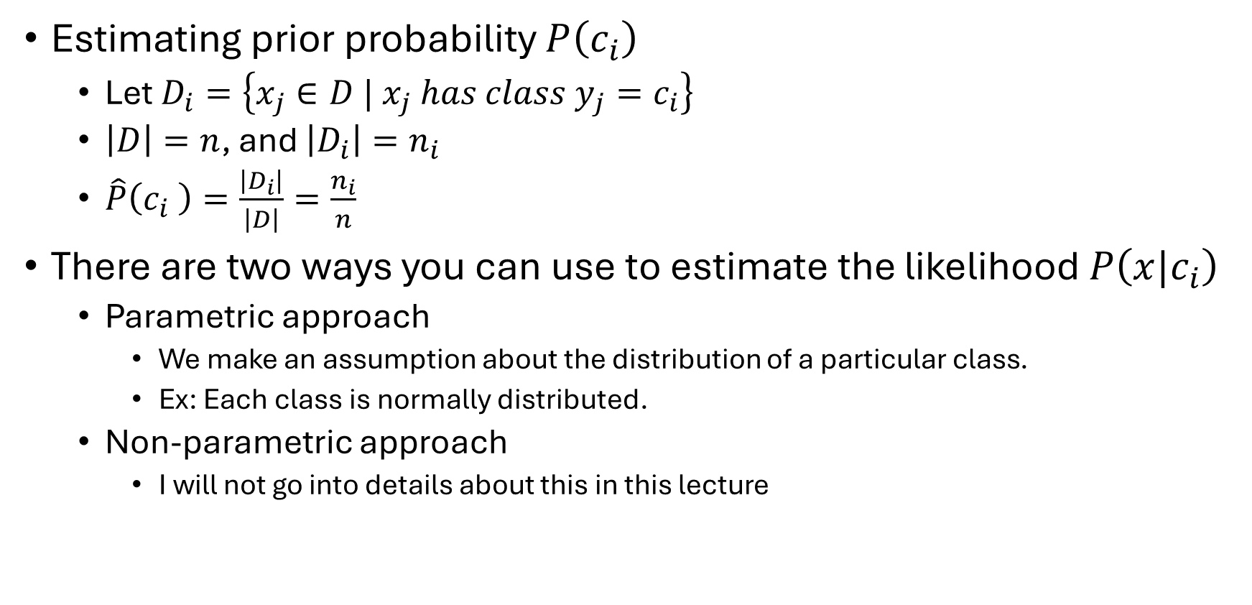
Bayes Theorem
Estimating prior probability $P\left(c_{i}\right)$
Let $D_{i}=\left\{x_{j}∈D | x_{j} has class y_{j}=c_{i}\right\}$
$\left|D\right|=n$, and $\left|D_{i}\right|=n_{i}$
$\hat{P}\left(c_{i} \right)=\frac{\left|D_{i}\right|}{\left|D\right|}=\frac{n_{i}}{n}$
There are two ways you can use to estimate the likelihood $P\left(x|c_{i}\right)$
Parametric approach
We make an assumption about the distribution of a particular class.
Ex: Each class is normally distributed.
Non-parametric approach
I will not go into details about this in this lecture

Slide 13
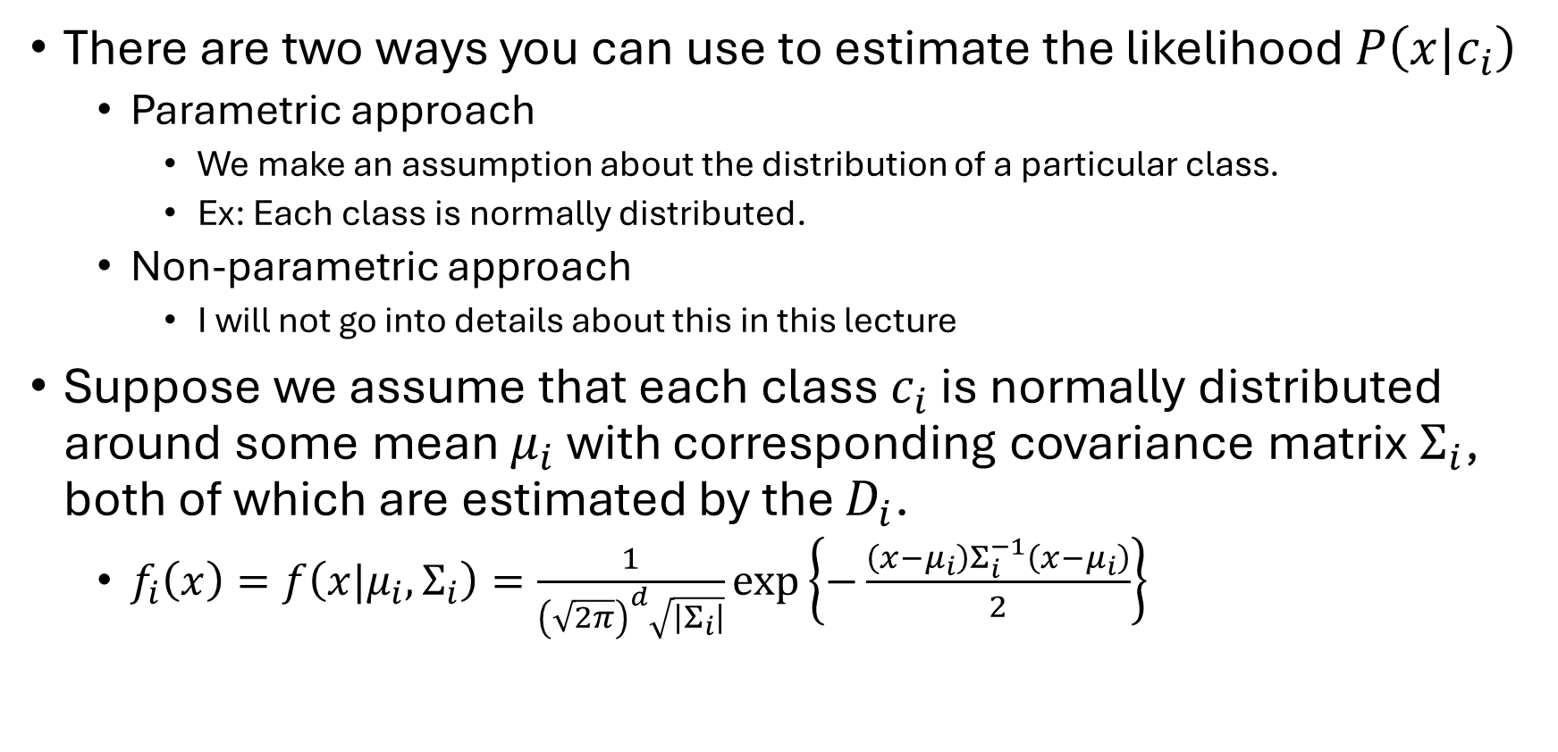
Bayes Theorem
There are two ways you can use to estimate the likelihood $P\left(x|c_{i}\right)$
Parametric approach
We make an assumption about the distribution of a particular class.
Ex: Each class is normally distributed.
Non-parametric approach
I will not go into details about this in this lecture
Suppose we assume that each class $c_{i}$ is normally distributed around some mean $μ_{i}$ with corresponding covariance matrix $Σ_{i}$, both of which are estimated by the $D_{i}$.
$f_{i}\left(x\right)=f\left(x|μ_{i}, Σ_{i}\right)=\frac{1}{{\left(\sqrt{2π}\right)}^{d}\sqrt{\left|Σ_{i}\right|}}\exp\left\{−\frac{\left(x−μ_{i}\right)Σ_{i}^{−1}\left(x−μ_{i}\right)}{2}\right\}$

Slide 14
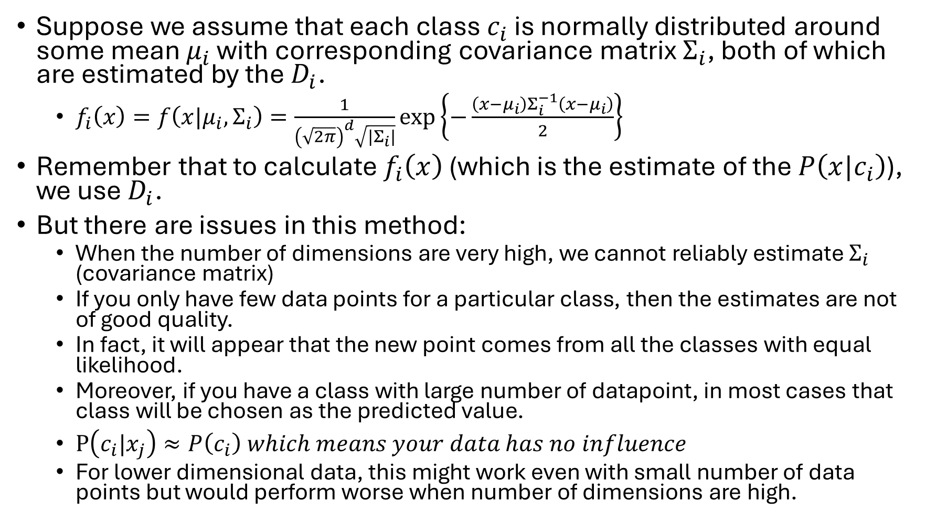
Bayes Theorem
Suppose we assume that each class $c_{i}$ is normally distributed around some mean $μ_{i}$ with corresponding covariance matrix $Σ_{i}$, both of which are estimated by the $D_{i}$.
$f_{i}\left(x\right)=f\left(x|μ_{i}, Σ_{i}\right)=\frac{1}{{\left(\sqrt{2π}\right)}^{d}\sqrt{\left|Σ_{i}\right|}}\exp\left\{−\frac{\left(x−μ_{i}\right)Σ_{i}^{−1}\left(x−μ_{i}\right)}{2}\right\}$
Remember that to calculate $f_{i}\left(x\right)$ (which is the estimate of the $P\left(x|c_{i}\right)$), we use $D_{i}$.
But there are issues in this method:
When the number of dimensions are very high, we cannot reliably estimate $Σ_{i}$ (covariance matrix)
If you only have few data points for a particular class, then the estimates are not of good quality.
In fact, it will appear that the new point comes from all the classes with equal likelihood.
Moreover, if you have a class with large number of datapoint, in most cases that class will be chosen as the predicted value.
$P\left(c_{i}|x_{j}\right)≈P\left(c_{i}\right) which means your data has no influence$
For lower dimensional data, this might work even with small number of data points but would perform worse when number of dimensions are high.

Slide 15
Bayes Theorem
Bayes classifier is the optimal classifier, if you know the probability distribution of all your data.
But as we discussed earlier, this is difficult to calculate.

Slide 16
Bayes Theorem
What is the solution?
We use an approach called naïve bayes.
This is even simpler method.
Surprisingly, this works very well for real world data.
Assumption:
We assume that our attributes are all independent

Slide 17
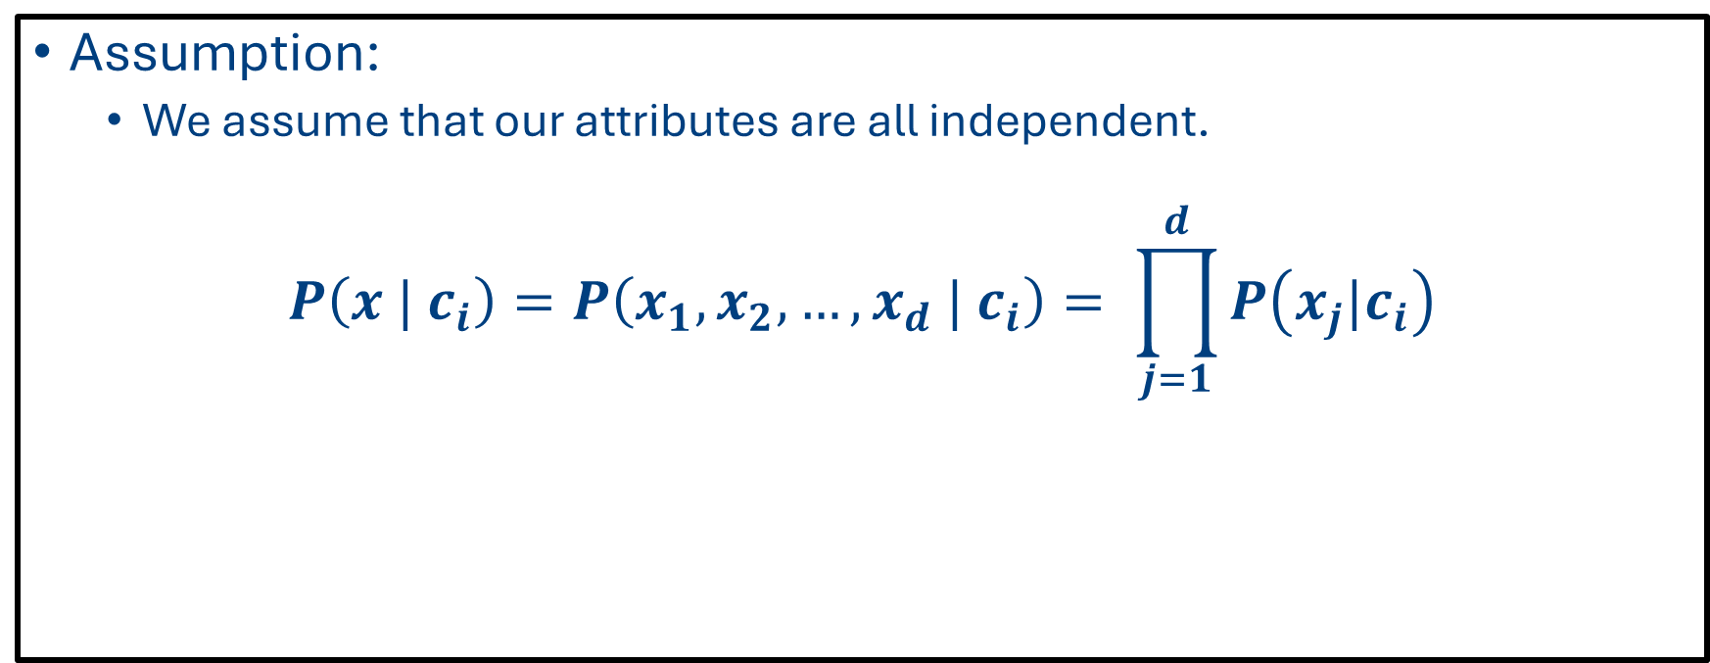
Bayes Theorem
Assumption:
We assume that our attributes are all independent.
$$P\left(x | c_{i}\right)=P\left(x_{1},x_{2},…, x_{d} | c_{i}\right)= \prod_{j=1}^{d}{P\left(x_{j}|c_{i}\right)}$$

Slide 18
Introduction to Naïve Bayes Algorithm
CSCI 347

Slide 19
Naïve Bayes is a classification algorithm
New data instance
Input data matrix
Weather | Weekend? | Finished HW | Go Hiking?
Sunny | Yes | No | ?
Weather | Weekend? | Finished HW | Go Hiking?
Snow | Yes | No | Yes
Overcast | No | No | No
Sunny | Yes | No | Yes
Overcast | Yes | Yes | Yes
Overcast | No | Yes | Yes
Snow | No | Yes | No
Overcast | Yes | No | No
Sunny | Yes | No | No
Sunny | No | Yes | Yes
Snow | No | Yes | Yes
Snow | Yes | No | No
Overcast | Yes | No | No
Overcast | No | Yes | Yes

Slide 20


Naïve Bayes
New data instance
Weather | Weekend? | Finished HW | Go Hiking?
Sunny | Yes | No | ?
Input data matrix
Class 1 $\left(c_{1}\right):"Yes"$
Weather | Weekend? | Finished HW | Go Hiking?
Snow | Yes | No | Yes
Overcast | No | No | No
Sunny | Yes | No | Yes
Overcast | Yes | Yes | Yes
Overcast | No | Yes | Yes
Snow | No | Yes | No
Overcast | Yes | No | No
Sunny | Yes | No | No
Sunny | No | Yes | Yes
Snow | No | Yes | Yes
Snow | Yes | No | No
Overcast | Yes | No | No
Overcast | No | Yes | Yes
Weather | Weekend? | Finished HW | Go Hiking?
Snow | Yes | No | Yes
Sunny | Yes | No | Yes
Overcast | Yes | Yes | Yes
Overcast | No | Yes | Yes
Sunny | No | Yes | Yes
Snow | No | Yes | Yes
Overcast | No | Yes | Yes
Class 2 $\left(c_{2}\right):"No"$
Weather | Weekend? | Finished HW | Go Hiking?
Overcast | No | No | No
Snow | No | Yes | No
Overcast | Yes | No | No
Sunny | Yes | No | No
Snow | Yes | No | No
Overcast | Yes | No | No

Slide 21




Naïve Bayes
New data instance
Weather | Weekend? | Finished HW | Go Hiking?
Sunny | Yes | No | ?
Input data matrix
Class 1 $\left(c_{1}\right):"Yes"$
Weather | Weekend? | Finished HW | Go Hiking?
Snow | Yes | No | Yes
Overcast | No | No | No
Sunny | Yes | No | Yes
Overcast | Yes | Yes | Yes
Overcast | No | Yes | Yes
Snow | No | Yes | No
Overcast | Yes | No | No
Sunny | Yes | No | No
Sunny | No | Yes | Yes
Snow | No | Yes | Yes
Snow | Yes | No | No
Overcast | Yes | No | No
Overcast | No | Yes | Yes
Weather | Weekend? | Finished HW | Go Hiking?
Snow | Yes | No | Yes
Sunny | Yes | No | Yes
Overcast | Yes | Yes | Yes
Overcast | No | Yes | Yes
Sunny | No | Yes | Yes
Snow | No | Yes | Yes
Overcast | No | Yes | Yes
$$n_{1}=7$$
Class 2 $\left(c_{2}\right):"No"$
Weather | Weekend? | Finished HW | Go Hiking?
Overcast | No | No | No
Snow | No | Yes | No
Overcast | Yes | No | No
Sunny | Yes | No | No
Snow | Yes | No | No
Overcast | Yes | No | No
$$n_{2}=6$$

Slide 22
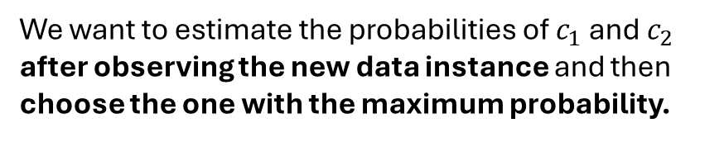


Naïve Bayes
New data instance
Weather | Weekend? | Finished HW | Go Hiking?
Sunny | Yes | No | ?
What is the probability of “Yes” and what is the probability of “No” in our data? (These are prior probabilities)
Class 1 $\left(c_{1}\right):"Yes"$
Weather | Weekend? | Finished HW | Go Hiking?
Snow | Yes | No | Yes
Sunny | Yes | No | Yes
Overcast | Yes | Yes | Yes
Overcast | No | Yes | Yes
Sunny | No | Yes | Yes
Snow | No | Yes | Yes
Overcast | No | Yes | Yes
$$n_{1}=7$$
$$p\left(c_{1}\right)=\frac{n_{1}}{n}=\frac{7}{13}=0.54$$
$$p\left(c_{2}\right)=\frac{n_{2}}{n}=\frac{6}{13}=0.46$$
We want to estimate the probabilities of $c_{1}$ and $c_{2}$ after observing the new data instance and then choose the one with the maximum probability.
Class 2 $\left(c_{2}\right):"No"$
Weather | Weekend? | Finished HW | Go Hiking?
Overcast | No | No | No
Snow | No | Yes | No
Overcast | Yes | No | No
Sunny | Yes | No | No
Snow | Yes | No | No
Overcast | Yes | No | No
$$n_{2}=6$$

Slide 23




Naïve Bayes
New data instance
Weather | Weekend? | Finished HW | Go Hiking?
Sunny | Yes | No | ?
What is the probability of “Yes” and what is the probability of “No” after observing the new data instance?
Class 1 $\left(c_{1}\right):"Yes"$
Weather | Weekend? | Finished HW | Go Hiking?
Snow | Yes | No | Yes
Sunny | Yes | No | Yes
Overcast | Yes | Yes | Yes
Overcast | No | Yes | Yes
Sunny | No | Yes | Yes
Snow | No | Yes | Yes
Overcast | No | Yes | Yes
$$p\left(c_{1}\right)=\frac{n_{1}}{n}=\frac{7}{13}=0.54$$
$$n_{1}=7$$
$$p\left(c_{1}| x\right)=?$$
$$p\left(c_{2}\right)=\frac{n_{2}}{n}=\frac{6}{13}=0.46$$
$$p\left(c_{2}| x\right)=?$$
Class 2 $\left(c_{2}\right):"No"$
Weather | Weekend? | Finished HW | Go Hiking?
Overcast | No | No | No
Snow | No | Yes | No
Overcast | Yes | No | No
Sunny | Yes | No | No
Snow | Yes | No | No
Overcast | Yes | No | No
$$n_{2}=6$$

Slide 24
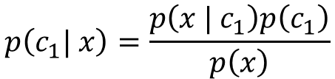


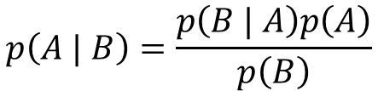
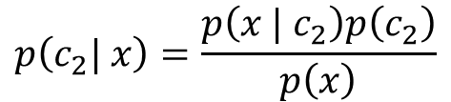
Naïve Bayes
New data instance
Weather | Weekend? | Finished HW | Go Hiking?
Sunny | Yes | No | ?
What is the probability of “Yes” and what is the probability of “No” after observing the new data instance?
We use Bayes’ Rule for this.
Class 1 $\left(c_{1}\right):"Yes"$
Weather | Weekend? | Finished HW | Go Hiking?
Snow | Yes | No | Yes
Sunny | Yes | No | Yes
Overcast | Yes | Yes | Yes
Overcast | No | Yes | Yes
Sunny | No | Yes | Yes
Snow | No | Yes | Yes
Overcast | No | Yes | Yes
$$p\left(A | B\right)=\frac{p\left(B | A\right)p\left(A\right)}{p\left(B\right)}$$
$$n_{1}=7$$
$$p\left(c_{1}\right)=\frac{n_{1}}{n}=\frac{7}{13}=0.54$$
$$p\left(c_{1}| x\right)=\frac{p\left(x | c_{1}\right)p\left(c_{1}\right)}{p\left(x\right)}$$
Class 2 $\left(c_{2}\right):"No"$
$$p\left(c_{2}\right)=\frac{n_{2}}{n}=\frac{6}{13}=0.46$$
Weather | Weekend? | Finished HW | Go Hiking?
Overcast | No | No | No
Snow | No | Yes | No
Overcast | Yes | No | No
Sunny | Yes | No | No
Snow | Yes | No | No
Overcast | Yes | No | No
$$n_{2}=6$$
$$p\left(c_{2}| x\right)=\frac{p\left(x | c_{2}\right)p\left(c_{2}\right)}{p\left(x\right)}$$

Slide 25


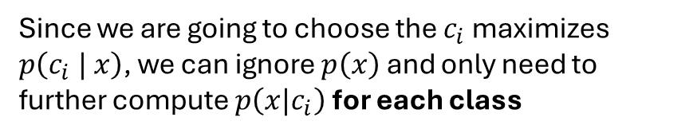
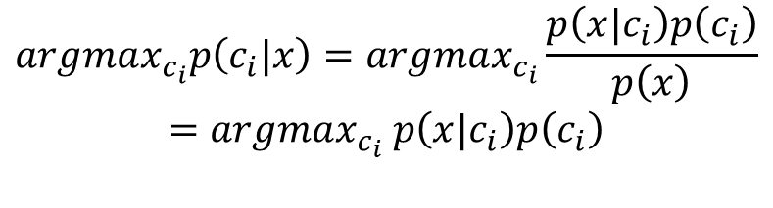
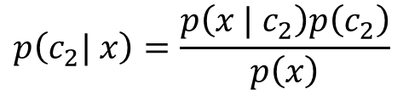
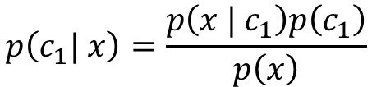
Naïve Bayes
New data instance
Weather | Weekend? | Finished HW | Go Hiking?
Sunny | Yes | No | ?
Since we are going to choose the $c_{i}$ maximizes $p\left(c_{i} | x\right)$, we can ignore $p\left(x\right)$ and only need to further compute $p\left(x|c_{i}\right)$ for each class
Class 1 $\left(c_{1}\right):"Yes"$
Weather | Weekend? | Finished HW | Go Hiking?
Snow | Yes | No | Yes
Sunny | Yes | No | Yes
Overcast | Yes | Yes | Yes
Overcast | No | Yes | Yes
Sunny | No | Yes | Yes
Snow | No | Yes | Yes
Overcast | No | Yes | Yes
$$argmax_{c_{i}}p\left(c_{i}|x\right)=argmax_{c_{i}}\frac{p\left(x|c_{i}\right)p\left(c_{i}\right)}{p\left(x\right)}$$
$$=argmax_{c_{i}} p\left(x|c_{i}\right)p\left(c_{i}\right)$$
$$n_{1}=7$$
$$p\left(c_{1}| x\right)=\frac{p\left(x | c_{1}\right)p\left(c_{1}\right)}{p\left(x\right)}$$
$$p\left(c_{2}| x\right)=\frac{p\left(x | c_{2}\right)p\left(c_{2}\right)}{p\left(x\right)}$$
Class 2 $\left(c_{2}\right):"No"$
$$p\left(c_{1}\right)=\frac{n_{1}}{n}=\frac{7}{13}=0.54$$
$$p\left(c_{2}\right)=\frac{n_{2}}{n}=\frac{6}{13}=0.46$$
Weather | Weekend? | Finished HW | Go Hiking?
Overcast | No | No | No
Snow | No | Yes | No
Overcast | Yes | No | No
Sunny | Yes | No | No
Snow | Yes | No | No
Overcast | Yes | No | No
$$n_{2}=6$$

Slide 26
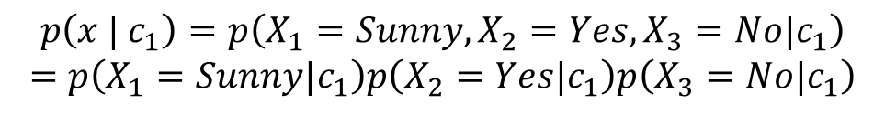
Naïve Bayes
New data instance
Weather | Weekend? | Finished HW | Go Hiking?
Sunny | Yes | No | ?
Since we are going to choose the $c_{i}$ maximizes $p\left(c_{i} | x\right)$, we can ignore $p\left(x\right)$ and only need to further compute $p\left(x|c_{i}\right)$ for each class
Class 1 $\left(c_{1}\right):"Yes"$
Weather | Weekend? | Finished HW | Go Hiking?
Snow | Yes | No | Yes
Sunny | Yes | No | Yes
Overcast | Yes | Yes | Yes
Overcast | No | Yes | Yes
Sunny | No | Yes | Yes
Snow | No | Yes | Yes
Overcast | No | Yes | Yes
$$argmax_{c_{i}}p\left(c_{i}|x\right)=argmax_{c_{i}}\frac{p\left(x|c_{i}\right)p\left(c_{i}\right)}{p\left(x\right)}$$
$$=argmax_{c_{i}} p\left(x|c_{i}\right)p\left(c_{i}\right)$$
$$n_{1}=7$$
$$p\left(c_{1}| x\right)=\frac{p\left(x | c_{1}\right)p\left(c_{1}\right)}{p\left(x\right)}$$
$$p\left(c_{2}| x\right)=\frac{p\left(x | c_{2}\right)p\left(c_{2}\right)}{p\left(x\right)}$$
Class 2 $\left(c_{2}\right):"No"$
$$p\left(c_{1}\right)=\frac{n_{1}}{n}=\frac{7}{13}=0.54$$
$$p\left(c_{2}\right)=\frac{n_{2}}{n}=\frac{6}{13}=0.46$$
Weather | Weekend? | Finished HW | Go Hiking?
Overcast | No | No | No
Snow | No | Yes | No
Overcast | Yes | No | No
Sunny | Yes | No | No
Snow | Yes | No | No
Overcast | Yes | No | No
$$n_{2}=6$$
$$p\left(x | c_{1}\right)=p\left(X_{1}=Sunny, X_{2}=Yes, X_{3}=No|c_{1}\right)$$
$$=p\left(X_{1}=Sunny|c_{1}\right)p\left(X_{2}=Yes|c_{1}\right)p\left(X_{3}=No|c_{1}\right)$$
Naïve Bayes assumes that attributes are independent

Slide 27
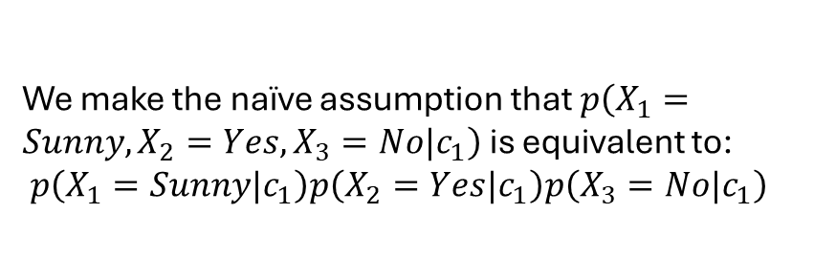
Naïve Bayes
New data instance
Weather | Weekend? | Finished HW | Go Hiking?
Sunny | Yes | No | ?
We make the naïve assumption that $p\left(X_{1}=Sunny, X_{2}=Yes, X_{3}=No|c_{1}\right)$ is equivalent to:
$p\left(X_{1}=Sunny|c_{1}\right)p\left(X_{2}=Yes|c_{1}\right)p\left(X_{3}=No|c_{1}\right)$
Class 1 $\left(c_{1}\right):"Yes"$
Weather | Weekend? | Finished HW | Go Hiking?
Snow | Yes | No | Yes
Sunny | Yes | No | Yes
Overcast | Yes | Yes | Yes
Overcast | No | Yes | Yes
Sunny | No | Yes | Yes
Snow | No | Yes | Yes
Overcast | No | Yes | Yes
$$argmax_{c_{i}}p\left(c_{i}|x\right)=argmax_{c_{i}}\frac{p\left(x|c_{i}\right)p\left(c_{i}\right)}{p\left(x\right)}$$
$$=argmax_{c_{i}} p\left(x|c_{i}\right)p\left(c_{i}\right)$$
$$n_{1}=7$$
$$p\left(c_{1}| x\right)=\frac{p\left(x | c_{1}\right)p\left(c_{1}\right)}{p\left(x\right)}$$
$$p\left(c_{2}| x\right)=\frac{p\left(x | c_{2}\right)p\left(c_{2}\right)}{p\left(x\right)}$$
Class 2 $\left(c_{2}\right):"No"$
$$p\left(c_{1}\right)=\frac{n_{1}}{n}=\frac{7}{13}=0.54$$
$$p\left(c_{2}\right)=\frac{n_{2}}{n}=\frac{6}{13}=0.46$$
Weather | Weekend? | Finished HW | Go Hiking?
Overcast | No | No | No
Snow | No | Yes | No
Overcast | Yes | No | No
Sunny | Yes | No | No
Snow | Yes | No | No
Overcast | Yes | No | No
$$n_{2}=6$$
$$p\left(x | c_{1}\right)=p\left(X_{1}=Sunny, X_{2}=Yes, X_{3}=No|c_{1}\right)$$
$$=p\left(X_{1}=Sunny|c_{1}\right)p\left(X_{2}=Yes|c_{1}\right)p\left(X_{3}=No|c_{1}\right)$$

Slide 28
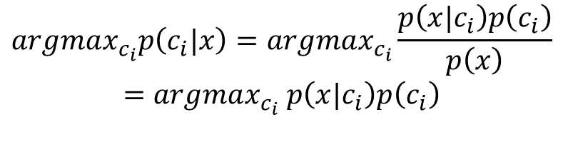
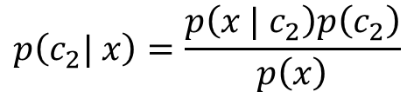
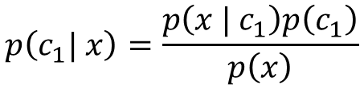

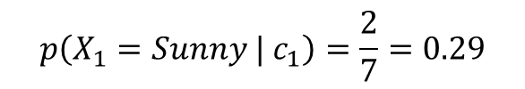

Naïve Bayes
New data instance
Weather | Weekend? | Finished HW | Go Hiking?
Sunny | Yes | No | ?
$$argmax_{c_{i}}p\left(c_{i}|x\right)=argmax_{c_{i}}\frac{p\left(x|c_{i}\right)p\left(c_{i}\right)}{p\left(x\right)}$$
$$=argmax_{c_{i}} p\left(x|c_{i}\right)p\left(c_{i}\right)$$
Class 1 $\left(c_{1}\right):"Yes"$
Weather | Weekend? | Finished HW | Go Hiking?
Snow | Yes | No | Yes
Sunny | Yes | No | Yes
Overcast | Yes | Yes | Yes
Overcast | No | Yes | Yes
Sunny | No | Yes | Yes
Snow | No | Yes | Yes
Overcast | No | Yes | Yes
$$p\left(c_{2}| x\right)=\frac{p\left(x | c_{2}\right)p\left(c_{2}\right)}{p\left(x\right)}$$
$$n_{1}=7$$
$$p\left(c_{1}| x\right)=\frac{p\left(x | c_{1}\right)p\left(c_{1}\right)}{p\left(x\right)}$$
$$p\left(c_{1}\right)=\frac{n_{1}}{n}=\frac{7}{13}=0.54$$
$$p\left(c_{2}\right)=\frac{n_{2}}{n}=\frac{6}{13}=0.46$$
$$p\left(x | c_{1}\right)=p\left(X_{1}=Sunny|c_{1}\right)p\left(X_{2}=Yes|c_{1}\right)p\left(X_{3}=No|c_{1}\right)$$
$$p\left(X_{1}=Sunny | c_{1}\right)=\frac{2}{7}=0.29$$

Slide 29
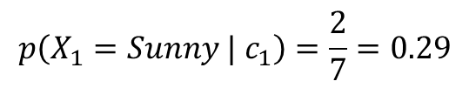
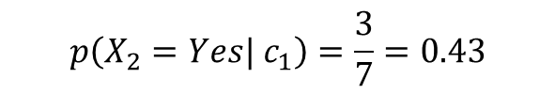
Naïve Bayes
New data instance
Weather | Weekend? | Finished HW | Go Hiking?
Sunny | Yes | No | ?
$$argmax_{c_{i}}p\left(c_{i}|x\right)=argmax_{c_{i}}\frac{p\left(x|c_{i}\right)p\left(c_{i}\right)}{p\left(x\right)}$$
$$=argmax_{c_{i}} p\left(x|c_{i}\right)p\left(c_{i}\right)$$
Class 1 $\left(c_{1}\right):"Yes"$
Weather | Weekend? | Finished HW | Go Hiking?
Snow | Yes | No | Yes
Sunny | Yes | No | Yes
Overcast | Yes | Yes | Yes
Overcast | No | Yes | Yes
Sunny | No | Yes | Yes
Snow | No | Yes | Yes
Overcast | No | Yes | Yes
$$p\left(c_{2}| x\right)=\frac{p\left(x | c_{2}\right)p\left(c_{2}\right)}{p\left(x\right)}$$
$$n_{1}=7$$
$$p\left(c_{1}| x\right)=\frac{p\left(x | c_{1}\right)p\left(c_{1}\right)}{p\left(x\right)}$$
$$p\left(c_{1}\right)=\frac{n_{1}}{n}=\frac{7}{13}=0.54$$
$$p\left(c_{2}\right)=\frac{n_{2}}{n}=\frac{6}{13}=0.46$$
$$p\left(x | c_{1}\right)=p\left(X_{1}=Sunny|c_{1}\right)p\left(X_{2}=Yes|c_{1}\right)p\left(X_{3}=No|c_{1}\right)$$
$$p\left(X_{1}=Sunny | c_{1}\right)=\frac{2}{7}=0.29$$
$$p\left(X_{2}=Yes| c_{1}\right)=\frac{3}{7}=0.43$$

Slide 30
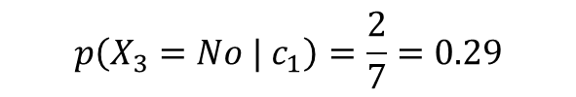
Naïve Bayes
New data instance
Weather | Weekend? | Finished HW | Go Hiking?
Sunny | Yes | No | ?
$$argmax_{c_{i}}p\left(c_{i}|x\right)=argmax_{c_{i}}\frac{p\left(x|c_{i}\right)p\left(c_{i}\right)}{p\left(x\right)}$$
$$=argmax_{c_{i}} p\left(x|c_{i}\right)p\left(c_{i}\right)$$
Class 1 $\left(c_{1}\right):"Yes"$
Weather | Weekend? | Finished HW | Go Hiking?
Snow | Yes | No | Yes
Sunny | Yes | No | Yes
Overcast | Yes | Yes | Yes
Overcast | No | Yes | Yes
Sunny | No | Yes | Yes
Snow | No | Yes | Yes
Overcast | No | Yes | Yes
$$p\left(c_{2}| x\right)=\frac{p\left(x | c_{2}\right)p\left(c_{2}\right)}{p\left(x\right)}$$
$$n_{1}=7$$
$$p\left(c_{1}| x\right)=\frac{p\left(x | c_{1}\right)p\left(c_{1}\right)}{p\left(x\right)}$$
$$p\left(c_{1}\right)=\frac{n_{1}}{n}=\frac{7}{13}=0.54$$
$$p\left(c_{2}\right)=\frac{n_{2}}{n}=\frac{6}{13}=0.46$$
$$p\left(x | c_{1}\right)=p\left(X_{1}=Sunny|c_{1}\right)p\left(X_{2}=Yes|c_{1}\right)p\left(X_{3}=No|c_{1}\right)$$
$$p\left(X_{1}=Sunny | c_{1}\right)=\frac{2}{7}=0.29$$
$$p\left(X_{2}=Yes| c_{1}\right)=\frac{3}{7}=0.43$$
$$p\left(X_{3}=No | c_{1}\right)=\frac{2}{7}=0.29$$

Slide 31
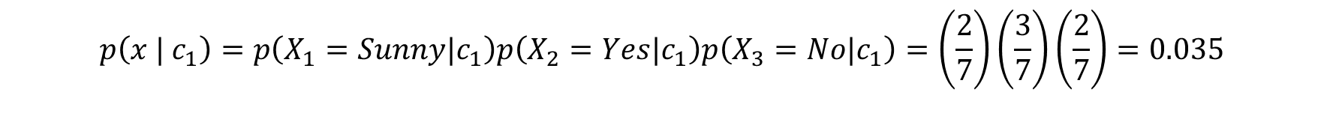
Naïve Bayes
New data instance
Weather | Weekend? | Finished HW | Go Hiking?
Sunny | Yes | No | ?
$$argmax_{c_{i}}p\left(c_{i}|x\right)=argmax_{c_{i}}\frac{p\left(x|c_{i}\right)p\left(c_{i}\right)}{p\left(x\right)}$$
$$=argmax_{c_{i}} p\left(x|c_{i}\right)p\left(c_{i}\right)$$
Class 1 $\left(c_{1}\right):"Yes"$
Weather | Weekend? | Finished HW | Go Hiking?
Snow | Yes | No | Yes
Sunny | Yes | No | Yes
Overcast | Yes | Yes | Yes
Overcast | No | Yes | Yes
Sunny | No | Yes | Yes
Snow | No | Yes | Yes
Overcast | No | Yes | Yes
$$p\left(c_{2}| x\right)=\frac{p\left(x | c_{2}\right)p\left(c_{2}\right)}{p\left(x\right)}$$
$$n_{1}=7$$
$$p\left(c_{1}| x\right)=\frac{p\left(x | c_{1}\right)p\left(c_{1}\right)}{p\left(x\right)}$$
$$p\left(c_{1}\right)=\frac{n_{1}}{n}=\frac{7}{13}=0.54$$
$$p\left(c_{2}\right)=\frac{n_{2}}{n}=\frac{6}{13}=0.46$$
$$p\left(x | c_{1}\right)=p\left(X_{1}=Sunny|c_{1}\right)p\left(X_{2}=Yes|c_{1}\right)p\left(X_{3}=No|c_{1}\right)=\left(\frac{2}{7}\right)\left(\frac{3}{7}\right)\left(\frac{2}{7}\right)=0.035$$
$$p\left(X_{1}=Sunny | c_{1}\right)=\frac{2}{7}=0.29$$
$$p\left(X_{2}=Yes| c_{1}\right)=\frac{3}{7}=0.43$$
$$p\left(X_{3}=No | c_{1}\right)=\frac{2}{7}=0.29$$

Slide 32

Naïve Bayes
New data instance
Weather | Weekend? | Finished HW | Go Hiking?
Sunny | Yes | No | ?
$$argmax_{c_{i}}p\left(c_{i}|x\right)=argmax_{c_{i}}\frac{p\left(x|c_{i}\right)p\left(c_{i}\right)}{p\left(x\right)}$$
$$=argmax_{c_{i}} p\left(x|c_{i}\right)p\left(c_{i}\right)$$
Class 1 $\left(c_{1}\right):"Yes"$
Weather | Weekend? | Finished HW | Go Hiking?
Snow | Yes | No | Yes
Sunny | Yes | No | Yes
Overcast | Yes | Yes | Yes
Overcast | No | Yes | Yes
Sunny | No | Yes | Yes
Snow | No | Yes | Yes
Overcast | No | Yes | Yes
$$p\left(c_{2}| x\right)=\frac{p\left(x | c_{2}\right)p\left(c_{2}\right)}{p\left(x\right)}$$
$$n_{1}=7$$
$$p\left(c_{1}| x\right)=\frac{p\left(x | c_{1}\right)p\left(c_{1}\right)}{p\left(x\right)}$$
$$p\left(c_{1}\right)=\frac{n_{1}}{n}=\frac{7}{13}=0.54$$
$$p\left(c_{2}\right)=\frac{n_{2}}{n}=\frac{6}{13}=0.46$$
$$p\left(x | c_{1}\right)p\left(c_{1} \right)=0.035\left(0.54\right)=0.0189$$

Slide 33


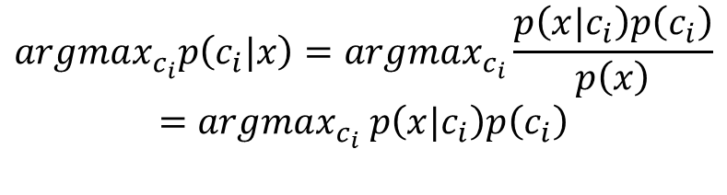

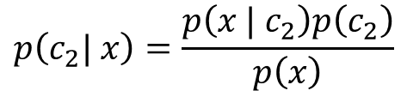
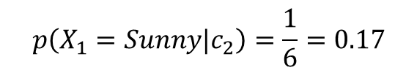
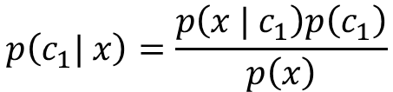
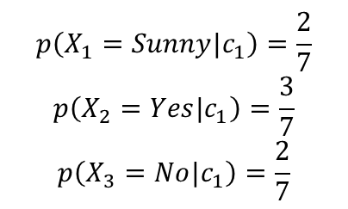


Naïve Bayes
New data instance
Weather | Weekend? | Finished HW | Go Hiking?
Sunny | Yes | No | ?
$$argmax_{c_{i}}p\left(c_{i}|x\right)=argmax_{c_{i}}\frac{p\left(x|c_{i}\right)p\left(c_{i}\right)}{p\left(x\right)}$$
$$=argmax_{c_{i}} p\left(x|c_{i}\right)p\left(c_{i}\right)$$
Class 2 $\left(c_{2}\right):"No"$
$$p\left(c_{1}| x\right)=\frac{p\left(x | c_{1}\right)p\left(c_{1}\right)}{p\left(x\right)}$$
$$p\left(c_{2}| x\right)=\frac{p\left(x | c_{2}\right)p\left(c_{2}\right)}{p\left(x\right)}$$
Weather | Weekend? | Finished HW | Go Hiking?
Overcast | No | No | No
Snow | No | Yes | No
Overcast | Yes | No | No
Sunny | Yes | No | No
Snow | Yes | No | No
Overcast | Yes | No | No
$$n_{2}=6$$
$$p\left(c_{1}\right)=\frac{n_{1}}{n}=\frac{7}{13}=0.54$$
$$p\left(c_{2}\right)=\frac{n_{2}}{n}=\frac{6}{13}=0.46$$
$$p\left(X_{1}=Sunny|c_{1}\right)=\frac{2}{7}$$
$$p\left(X_{2}=Yes|c_{1}\right)=\frac{3}{7}$$
$$p\left(X_{3}=No|c_{1}\right)=\frac{2}{7}$$
$$p\left(X_{1}=Sunny|c_{2}\right)=\frac{1}{6}=0.17$$
$$p\left(x | c_{1}\right)p\left(c_{1} \right)=0.0189$$

Slide 34


Naïve Bayes
New data instance
Weather | Weekend? | Finished HW | Go Hiking?
Sunny | Yes | No | ?
$$argmax_{c_{i}}p\left(c_{i}|x\right)=argmax_{c_{i}}\frac{p\left(x|c_{i}\right)p\left(c_{i}\right)}{p\left(x\right)}$$
$$=argmax_{c_{i}} p\left(x|c_{i}\right)p\left(c_{i}\right)$$
Class 2 $\left(c_{2}\right):"No"$
$$p\left(c_{1}| x\right)=\frac{p\left(x | c_{1}\right)p\left(c_{1}\right)}{p\left(x\right)}$$
$$p\left(c_{2}| x\right)=\frac{p\left(x | c_{2}\right)p\left(c_{2}\right)}{p\left(x\right)}$$
Weather | Weekend? | Finished HW | Go Hiking?
Overcast | No | No | No
Snow | No | Yes | No
Overcast | Yes | No | No
Sunny | Yes | No | No
Snow | Yes | No | No
Overcast | Yes | No | No
$$n_{2}=6$$
$$p\left(c_{1}\right)=\frac{n_{1}}{n}=\frac{7}{13}=0.54$$
$$p\left(c_{2}\right)=\frac{n_{2}}{n}=\frac{6}{13}=0.46$$
$$p\left(X_{1}=Sunny|c_{1}\right)=\frac{2}{7}$$
$$p\left(X_{2}=Yes|c_{1}\right)=\frac{3}{7}$$
$$p\left(X_{3}=No|c_{1}\right)=\frac{2}{7}$$
$$p\left(X_{1}=Sunny|c_{2}\right)=\frac{1}{6}=0.17$$
$$p\left(X_{2}=Yes|c_{2}\right)=\frac{4}{6}=0.67$$
$$p\left(x | c_{1}\right)p\left(c_{1} \right)=0.0189$$

Slide 35


Naïve Bayes
New data instance
Weather | Weekend? | Finished HW | Go Hiking?
Sunny | Yes | No | ?
$$argmax_{c_{i}}p\left(c_{i}|x\right)=argmax_{c_{i}}\frac{p\left(x|c_{i}\right)p\left(c_{i}\right)}{p\left(x\right)}$$
$$=argmax_{c_{i}} p\left(x|c_{i}\right)p\left(c_{i}\right)$$
Class 2 $\left(c_{2}\right):"No"$
$$p\left(c_{1}| x\right)=\frac{p\left(x | c_{1}\right)p\left(c_{1}\right)}{p\left(x\right)}$$
$$p\left(c_{2}| x\right)=\frac{p\left(x | c_{2}\right)p\left(c_{2}\right)}{p\left(x\right)}$$
Weather | Weekend? | Finished HW | Go Hiking?
Overcast | No | No | No
Snow | No | Yes | No
Overcast | Yes | No | No
Sunny | Yes | No | No
Snow | Yes | No | No
Overcast | Yes | No | No
$$n_{2}=6$$
$$p\left(c_{1}\right)=\frac{n_{1}}{n}=\frac{7}{13}=0.54$$
$$p\left(c_{2}\right)=\frac{n_{2}}{n}=\frac{6}{13}=0.46$$
$$p\left(X_{1}=Sunny|c_{1}\right)=\frac{2}{7}$$
$$p\left(X_{2}=Yes|c_{1}\right)=\frac{3}{7}$$
$$p\left(X_{3}=No|c_{1}\right)=\frac{2}{7}$$
$$p\left(X_{1}=Sunny|c_{2}\right)=\frac{1}{6}=0.17$$
$$p\left(X_{2}=Yes|c_{2}\right)=\frac{4}{6}=0.67$$
$$p\left(x | c_{1}\right)p\left(c_{1} \right)=0.0189$$
$$p\left(X_{3}=No|c_{2}\right)=\frac{5}{6}=0.83$$

Slide 36

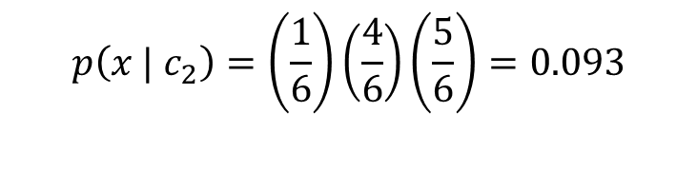
Naïve Bayes
New data instance
Weather | Weekend? | Finished HW | Go Hiking?
Sunny | Yes | No | ?
$$argmax_{c_{i}}p\left(c_{i}|x\right)=argmax_{c_{i}}\frac{p\left(x|c_{i}\right)p\left(c_{i}\right)}{p\left(x\right)}$$
$$=argmax_{c_{i}} p\left(x|c_{i}\right)p\left(c_{i}\right)$$
Class 2 $\left(c_{2}\right):"No"$
$$p\left(c_{1}| x\right)=\frac{p\left(x | c_{1}\right)p\left(c_{1}\right)}{p\left(x\right)}$$
$$p\left(c_{2}| x\right)=\frac{p\left(x | c_{2}\right)p\left(c_{2}\right)}{p\left(x\right)}$$
Weather | Weekend? | Finished HW | Go Hiking?
Overcast | No | No | No
Snow | No | Yes | No
Overcast | Yes | No | No
Sunny | Yes | No | No
Snow | Yes | No | No
Overcast | Yes | No | No
$$n_{2}=6$$
$$p\left(c_{1}\right)=\frac{n_{1}}{n}=\frac{7}{13}=0.54$$
$$p\left(c_{2}\right)=\frac{n_{2}}{n}=\frac{6}{13}=0.46$$
$$p\left(X_{1}=Sunny|c_{1}\right)=\frac{2}{7}$$
$$p\left(X_{2}=Yes|c_{1}\right)=\frac{3}{7}$$
$$p\left(X_{3}=No|c_{1}\right)=\frac{2}{7}$$
$$p\left(X_{1}=Sunny|c_{2}\right)=\frac{1}{6}=0.17$$
$$p\left(X_{2}=Yes|c_{2}\right)=\frac{4}{6}=0.67$$
$$p\left(X_{3}=No|c_{2}\right)=\frac{5}{6}=0.83$$
$$p\left(x | c_{1}\right)p\left(c_{1} \right)=0.0189$$
$$p\left(x | c_{2}\right)=\left(\frac{1}{6}\right)\left(\frac{4}{6}\right)\left(\frac{5}{6}\right)=0.093$$

Slide 37
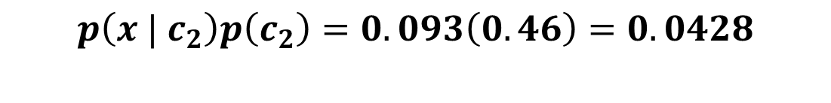
Naïve Bayes
New data instance
Weather | Weekend? | Finished HW | Go Hiking?
Sunny | Yes | No | ?
$$argmax_{c_{i}}p\left(c_{i}|x\right)=argmax_{c_{i}}\frac{p\left(x|c_{i}\right)p\left(c_{i}\right)}{p\left(x\right)}$$
$$=argmax_{c_{i}} p\left(x|c_{i}\right)p\left(c_{i}\right)$$
Class 2 $\left(c_{2}\right):"No"$
$$p\left(c_{1}| x\right)=\frac{p\left(x | c_{1}\right)p\left(c_{1}\right)}{p\left(x\right)}$$
$$p\left(c_{2}| x\right)=\frac{p\left(x | c_{2}\right)p\left(c_{2}\right)}{p\left(x\right)}$$
Weather | Weekend? | Finished HW | Go Hiking?
Overcast | No | No | No
Snow | No | Yes | No
Overcast | Yes | No | No
Sunny | Yes | No | No
Snow | Yes | No | No
Overcast | Yes | No | No
$$n_{2}=6$$
$$p\left(c_{1}\right)=\frac{n_{1}}{n}=\frac{7}{13}=0.54$$
$$p\left(c_{2}\right)=\frac{n_{2}}{n}=\frac{6}{13}=0.46$$
$$p\left(X_{1}=Sunny|c_{1}\right)=\frac{2}{7}$$
$$p\left(X_{2}=Yes|c_{1}\right)=\frac{3}{7}$$
$$p\left(X_{3}=No|c_{1}\right)=\frac{2}{7}$$
$$p\left(X_{1}=Sunny|c_{2}\right)=\frac{1}{6}=0.17$$
$$p\left(X_{2}=Yes|c_{2}\right)=\frac{4}{6}=0.67$$
$$p\left(X_{3}=No|c_{2}\right)=\frac{5}{6}=0.83$$
$$p\left(x | c_{1}\right)p\left(c_{1} \right)=0.0189$$
$$p\left(x | c_{2}\right)p\left(c_{2}\right)=0.093\left(0.46\right)=0.0428$$

Slide 38
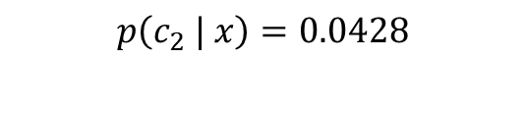

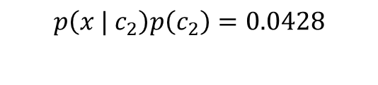
Naïve Bayes
New data instance
Weather | Weekend? | Finished HW | Go Hiking?
Sunny | Yes | No | ?
$$argmax_{c_{i}}p\left(c_{i}|x\right)=argmax_{c_{i}}\frac{p\left(x|c_{i}\right)p\left(c_{i}\right)}{p\left(x\right)}$$
$$=argmax_{c_{i}} p\left(x|c_{i}\right)p\left(c_{i}\right)$$
Class 2 $\left(c_{2}\right):"No"$
$$p\left(c_{1}| x\right)=\frac{p\left(x | c_{1}\right)p\left(c_{1}\right)}{p\left(x\right)}$$
$$p\left(c_{2}| x\right)=\frac{p\left(x | c_{2}\right)p\left(c_{2}\right)}{p\left(x\right)}$$
Weather | Weekend? | Finished HW | Go Hiking?
Overcast | No | No | No
Snow | No | Yes | No
Overcast | Yes | No | No
Sunny | Yes | No | No
Snow | Yes | No | No
Overcast | Yes | No | No
$$n_{2}=6$$
$$p\left(c_{1}\right)=\frac{n_{1}}{n}=\frac{7}{13}=0.54$$
$$p\left(c_{2}\right)=\frac{n_{2}}{n}=\frac{6}{13}=0.46$$
$$p\left(X_{1}=Sunny|c_{1}\right)=\frac{2}{7}$$
$$p\left(X_{2}=Yes|c_{1}\right)=\frac{3}{7}$$
$$p\left(X_{3}=No|c_{1}\right)=\frac{2}{7}$$
$$p\left(X_{1}=Sunny|c_{2}\right)=\frac{1}{6}=0.17$$
$$p\left(X_{2}=Yes|c_{2}\right)=\frac{4}{6}=0.67$$
$$p\left(X_{3}=No|c_{2}\right)=\frac{5}{6}=0.83$$
$$p\left(x | c_{1}\right)p\left(c_{1} \right)=0.0189$$
$$p\left(x | c_{2}\right)p\left(c_{2}\right)=0.0428$$
$$p\left(c_{1} | x\right)=0.0189$$
$$p\left(c_{2} | x\right)=0.0428$$

Slide 39
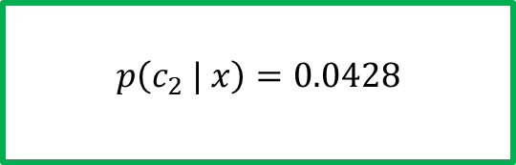
Naïve Bayes
New data instance
Weather | Weekend? | Finished HW | Go Hiking?
Sunny | Yes | No | ?
$$argmax_{c_{i}}p\left(c_{i}|x\right)=argmax_{c_{i}}\frac{p\left(x|c_{i}\right)p\left(c_{i}\right)}{p\left(x\right)}$$
$$=argmax_{c_{i}} p\left(x|c_{i}\right)p\left(c_{i}\right)$$
Class 2 $\left(c_{2}\right):"No"$
$$p\left(c_{1}| x\right)=\frac{p\left(x | c_{1}\right)p\left(c_{1}\right)}{p\left(x\right)}$$
$$p\left(c_{2}| x\right)=\frac{p\left(x | c_{2}\right)p\left(c_{2}\right)}{p\left(x\right)}$$
Weather | Weekend? | Finished HW | Go Hiking?
Overcast | No | No | No
Snow | No | Yes | No
Overcast | Yes | No | No
Sunny | Yes | No | No
Snow | Yes | No | No
Overcast | Yes | No | No
$$n_{2}=6$$
$$p\left(c_{1}\right)=\frac{n_{1}}{n}=\frac{7}{13}=0.54$$
$$p\left(c_{2}\right)=\frac{n_{2}}{n}=\frac{6}{13}=0.46$$
$$p\left(X_{1}=Sunny|c_{1}\right)=\frac{2}{7}$$
$$p\left(X_{2}=Yes|c_{1}\right)=\frac{3}{7}$$
$$p\left(X_{3}=No|c_{1}\right)=\frac{2}{7}$$
$$p\left(X_{1}=Sunny|c_{2}\right)=\frac{1}{6}=0.17$$
$$p\left(X_{2}=Yes|c_{2}\right)=\frac{4}{6}=0.67$$
$$p\left(X_{3}=No|c_{2}\right)=\frac{5}{6}=0.83$$
$$p\left(x | c_{1}\right)p\left(c_{1} \right)=0.0189$$
$$p\left(x | c_{2}\right)p\left(c_{2}\right)=0.0428$$
$$p\left(c_{1} | x\right)=0.0189$$
$$p\left(c_{2} | x\right)=0.0428$$

Slide 40
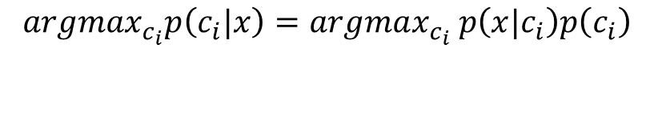
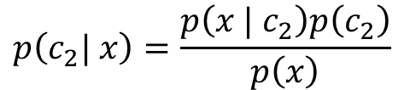
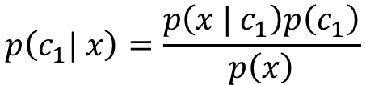
Naïve Bayes for numerical attributes
New data instance
Inches of rain in past 2 hours | Hours of sleep in previous night | Percentage of HW completed? | Go Hiking?
2.3 | 7 | 75 | ?
$$argmax_{c_{i}}p\left(c_{i}|x\right)=argmax_{c_{i}} p\left(x|c_{i}\right)p\left(c_{i}\right)$$
$$p\left(c_{1}| x\right)=\frac{p\left(x | c_{1}\right)p\left(c_{1}\right)}{p\left(x\right)}$$
$$p\left(c_{2}| x\right)=\frac{p\left(x | c_{2}\right)p\left(c_{2}\right)}{p\left(x\right)}$$
Inches of rain in past 2 hours | Hours of sleep in previous night | Percentage of HW completed? | Go Hiking?
0 | 9 | 80 | Yes
0.5 | 5 | 90 | No
1 | 7 | 95 | Yes
5 | 7 | 100 | Yes
0.3 | 8 | 100 | Yes
0.4 | 4 | 100 | No
0.1 | 9 | 27 | No
0 | 9 | 50 | No
0 | 8 | 100 | Yes
3 | 10 | 98 | Yes
6 | 8 | 95 | No
2.1 | 8 | 70 | No
1.02 | 8.5 | 98 | Yes

Slide 41




Naïve Bayes for numerical attributes
New data instance
Inches of rain in past 2 hours | Hours of sleep in previous night | Percentage of HW completed? | Go Hiking?
2.3 | 7 | 75 | ?
$$argmax_{c_{i}}p\left(c_{i}|x\right)=argmax_{c_{i}} p\left(x|c_{i}\right)p\left(c_{i}\right)$$
$$p\left(c_{1}| x\right)=\frac{p\left(x | c_{1}\right)p\left(c_{1}\right)}{p\left(x\right)}$$
$$p\left(c_{2}| x\right)=\frac{p\left(x | c_{2}\right)p\left(c_{2}\right)}{p\left(x\right)}$$
$$p\left(c_{1}\right)=\frac{n_{1}}{n}=\frac{7}{13}=0.54$$
$$p\left(c_{2}\right)=\frac{n_{2}}{n}=\frac{6}{13}=0.46$$
Inches of rain in past 2 hours | Hours of sleep in previous night | Percentage of HW completed? | Go Hiking?
0 | 9 | 80 | Yes
0.5 | 5 | 90 | No
1 | 7 | 95 | Yes
5 | 7 | 100 | Yes
0.3 | 8 | 100 | Yes
0.4 | 4 | 100 | No
0.1 | 9 | 27 | No
0 | 9 | 50 | No
0 | 8 | 100 | Yes
3 | 10 | 98 | Yes
6 | 8 | 95 | No
2.1 | 8 | 70 | No
1.02 | 8.5 | 98 | Yes
$$p\left(x | c_{1}\right)=?$$
$$p\left(x | c_{2}\right)=?$$

Slide 42
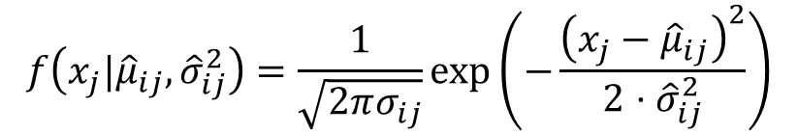
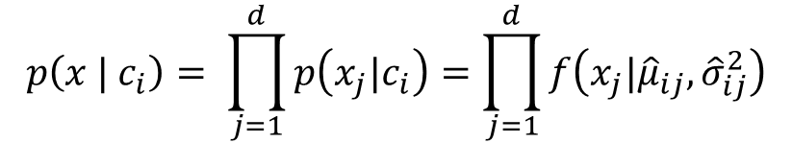
Naïve Bayes for numerical attributes
New data instance
Inches of rain in past 2 hours | Hours of sleep in previous night | Percentage of HW completed? | Go Hiking?
2.3 | 7 | 75 | ?
$$argmax_{c_{i}}p\left(c_{i}|x\right)=argmax_{c_{i}} p\left(x|c_{i}\right)p\left(c_{i}\right)$$
$$p\left(c_{1}| x\right)=\frac{p\left(x | c_{1}\right)p\left(c_{1}\right)}{p\left(x\right)}$$
$$p\left(c_{2}| x\right)=\frac{p\left(x | c_{2}\right)p\left(c_{2}\right)}{p\left(x\right)}$$
$$p\left(c_{1}\right)=\frac{n_{1}}{n}=\frac{7}{13}=0.54$$
$$p\left(c_{2}\right)=\frac{n_{2}}{n}=\frac{6}{13}=0.46$$
Inches of rain in past 2 hours | Hours of sleep in previous night | Percentage of HW completed? | Go Hiking?
0 | 9 | 80 | Yes
0.5 | 5 | 90 | No
1 | 7 | 95 | Yes
5 | 7 | 100 | Yes
0.3 | 8 | 100 | Yes
0.4 | 4 | 100 | No
0.1 | 9 | 27 | No
0 | 9 | 50 | No
0 | 8 | 100 | Yes
3 | 10 | 98 | Yes
6 | 8 | 95 | No
2.1 | 8 | 70 | No
1.02 | 8.5 | 98 | Yes
$$p\left(x | c_{1}\right)=?$$
$$p\left(x | c_{2}\right)=?$$
Assume each class has a normal distribution with the assumption that attributes are independent
$$p\left(x | c_{i}\right)= \prod_{j=1}^{d}{p\left(x_{j}|c_{i}\right)}=\prod_{j=1}^{d}{f\left(x_{j}|{\hat{μ}}_{ij}, {\hat{σ}}_{ij}^{2}\right)}$$
Where:
$$f\left(x_{j}|{\hat{μ}}_{ij}, {\hat{σ}}_{ij}^{2}\right)=\frac{1}{\sqrt{2πσ_{ij}}}\exp\left(−\frac{{\left(x_{j}−{\hat{μ}}_{ij}\right)}^{2}}{2⋅{\hat{σ}}_{ij}^{2}}\right)$$

Slide 43

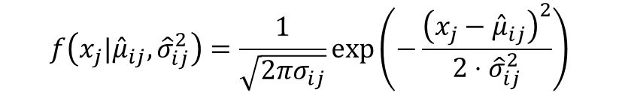
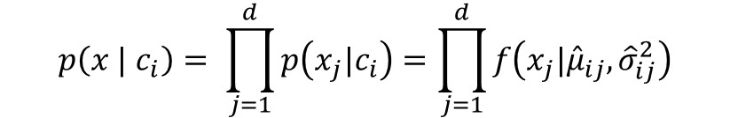
Naïve Bayes for numerical attributes
New data instance
Inches of rain in past 2 hours | Hours of sleep in previous night | Percentage of HW completed? | Go Hiking?
2.3 | 7 | 75 | ?
$$argmax_{c_{i}}p\left(c_{i}|x\right)=argmax_{c_{i}} p\left(x|c_{i}\right)p\left(c_{i}\right)$$
$$p\left(c_{1}| x\right)=\frac{p\left(x | c_{1}\right)p\left(c_{1}\right)}{p\left(x\right)}$$
$$p\left(c_{2}| x\right)=\frac{p\left(x | c_{2}\right)p\left(c_{2}\right)}{p\left(x\right)}$$
$$p\left(c_{1}\right)=\frac{n_{1}}{n}=\frac{7}{13}=0.54$$
$$p\left(c_{2}\right)=\frac{n_{2}}{n}=\frac{6}{13}=0.46$$
Inches of rain in past 2 hours | Hours of sleep in previous night | Percentage of HW completed? | Go Hiking?
0 | 9 | 80 | Yes
0.5 | 5 | 90 | No
1 | 7 | 95 | Yes
5 | 7 | 100 | Yes
0.3 | 8 | 100 | Yes
0.4 | 4 | 100 | No
0.1 | 9 | 27 | No
0 | 9 | 50 | No
0 | 8 | 100 | Yes
3 | 10 | 98 | Yes
6 | 8 | 95 | No
2.1 | 8 | 70 | No
1.02 | 8.5 | 98 | Yes
$$p\left(x | c_{1}\right)=?$$
$$p\left(x | c_{2}\right)=?$$
$$p\left(x | c_{i}\right)= \prod_{j=1}^{d}{p\left(x_{j}|c_{i}\right)}=\prod_{j=1}^{d}{f\left(x_{j}|{\hat{μ}}_{ij}, {\hat{σ}}_{ij}^{2}\right)}$$
$$f\left(x_{j}|{\hat{μ}}_{ij}, {\hat{σ}}_{ij}^{2}\right)=\frac{1}{\sqrt{2πσ_{ij}}}\exp\left(−\frac{{\left(x_{j}−{\hat{μ}}_{ij}\right)}^{2}}{2⋅{\hat{σ}}_{ij}^{2}}\right)$$

Slide 44
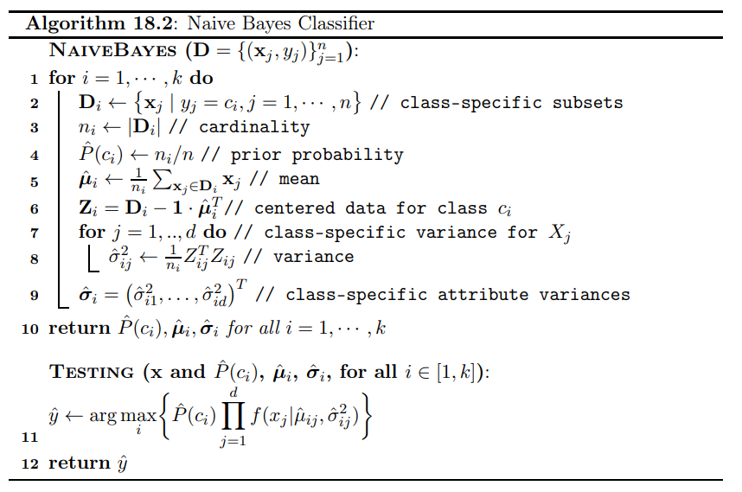
Naïve Bayes algorithm (numerical attributes)

Slide 45
Evaluating classification algorithms
CSCI 347
Adiesha Liyana Ralalage

Slide 46
Evaluation of Classification
Input data matrix
Class labels are always categorical
New data instance
Weather | Weekend? | Finished HW | Go Hiking?
Snow | Yes | No | Yes
Overcast | No | No | No
Sunny | Yes | No | Yes
Overcast | Yes | Yes | Yes
Overcast | No | Yes | Yes
Snow | No | Yes | No
Overcast | Yes | No | No
Sunny | Yes | No | No
Sunny | No | Yes | Yes
Snow | No | Yes | Yes
Snow | Yes | No | No
Overcast | Yes | No | No
Overcast | No | Yes | Yes
Weather | Weekend? | Finished HW | Go Hiking?
Sunny | Yes | No | ?
Goal is to predict the class of the new data

Slide 47
TRAINING SET AND TEST SET
Test data instance
Weather | Weekend? | Finished HW | Go Hiking?
Snow | Yes | No | Yes
Input data matrix
Weather | Weekend? | Finished HW | Go Hiking?
Snow | Yes | No | Yes
Overcast | No | No | No
Sunny | Yes | No | Yes
Overcast | Yes | Yes | Yes
Overcast | No | Yes | Yes
Snow | No | Yes | No
Overcast | Yes | No | No
Sunny | Yes | No | No
Sunny | No | Yes | Yes
Snow | No | Yes | Yes
Snow | Yes | No | No
Overcast | Yes | No | No
Overcast | No | Yes | Yes
Evaluate the class predictions of test data

Slide 48
TRAINING SET AND TEST SET
Test data instance
Input data matrix
Weather | Weekend? | Finished HW | Go Hiking?
Snow | Yes | No | Yes
Weather | Weekend? | Finished HW | Go Hiking?
Snow | Yes | No | Yes
Overcast | No | No | No
Sunny | Yes | No | Yes
Overcast | Yes | Yes | Yes
Overcast | No | Yes | Yes
Snow | No | Yes | No
Overcast | Yes | No | No
Sunny | Yes | No | No
Sunny | No | Yes | Yes
Snow | No | Yes | Yes
Snow | Yes | No | No
Overcast | Yes | No | No
Overcast | No | Yes | Yes
Evaluate the model using a subset of test data that you picked, which you did not use to create the model.
Weather | Weekend? | Finished HW | Go Hiking?
Overcast | No | No | No
Sunny | Yes | No | Yes
Overcast | Yes | Yes | Yes
Overcast | No | Yes | Yes
Snow | No | Yes | No
Overcast | Yes | No | No
Sunny | Yes | No | No
Sunny | No | Yes | Yes
Snow | No | Yes | Yes
Snow | Yes | No | No
Overcast | Yes | No | No
Overcast | No | Yes | Yes

Slide 49
TRAINING SET AND TEST SET
Test data instance
Weather | Weekend? | Finished HW | Go Hiking?
Snow | Yes | No | Yes
Overcast | Yes | Yes | Yes
Snow | No | Yes | Yes
Often split 80/20
Input data matrix
Weather | Weekend? | Finished HW | Go Hiking?
Snow | Yes | No | Yes
Overcast | No | No | No
Sunny | Yes | No | Yes
Overcast | Yes | Yes | Yes
Overcast | No | Yes | Yes
Snow | No | Yes | No
Overcast | Yes | No | No
Sunny | Yes | No | No
Sunny | No | Yes | Yes
Snow | No | Yes | Yes
Snow | Yes | No | No
Overcast | Yes | No | No
Overcast | No | Yes | Yes
Evaluate the class predictions of test data based on an algorithm that built a model using only training data.
Training data
Weather | Weekend? | Finished HW | Go Hiking?
Overcast | No | No | No
Sunny | Yes | No | Yes
Overcast | No | Yes | Yes
Snow | No | Yes | No
Overcast | Yes | No | No
Sunny | Yes | No | No
Sunny | No | Yes | Yes
Snow | Yes | No | No
Overcast | Yes | No | No
Overcast | No | Yes | Yes

Slide 50
Pipeline of evaluation
Test data instance
Training data
Weather | Weekend? | Finished HW | Go Hiking?
Snow | Yes | No | Yes
Overcast | Yes | Yes | Yes
Snow | No | Yes | Yes
Weather | Weekend? | Finished HW | Go Hiking?
Overcast | No | No | No
Sunny | Yes | No | Yes
Overcast | No | Yes | Yes
Snow | No | Yes | No
Overcast | Yes | No | No
Sunny | Yes | No | No
Sunny | No | Yes | Yes
Snow | Yes | No | No
Overcast | Yes | No | No
Overcast | No | Yes | Yes
Feed the model unlabeled test data to make predictions
“predict the test data classes”
Weather | Weekend? | Finished HW | Go Hiking?
Snow | Yes | No | Yes
Overcast | Yes | Yes | Yes
Snow | No | Yes | No
Give a classification algorithm training data to use to output a model
Compare the predicted classes to ground truth classes

Slide 51
Evaluation metrics
How to compare the predicted classes to ground truth classes?
Predicted classes
Test data instance
Weather | Weekend? | Finished HW | Go Hiking?
Snow | Yes | No | Yes
Overcast | Yes | Yes | Yes
Snow | No | Yes | No
Weather | Weekend? | Finished HW | Go Hiking?
Snow | Yes | No | Yes
Overcast | Yes | Yes | Yes
Snow | No | Yes | Yes

Slide 52
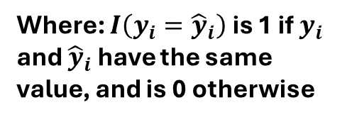
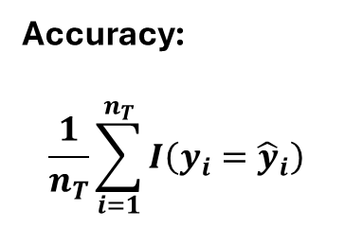
Evaluation metrics
How to compare the predicted classes to ground truth classes?
Predicted classes
Test data instance
Weather | Weekend? | Finished HW | Go Hiking?
Snow | Yes | No | Yes
Overcast | Yes | Yes | Yes
Snow | No | Yes | No
Weather | Weekend? | Finished HW | Go Hiking?
Snow | Yes | No | Yes
Overcast | Yes | Yes | Yes
Snow | No | Yes | Yes
Accuracy:
$$\frac{1}{n_{T}}\sum_{i=1}^{n_{T}}{I\left(y_{i}={\hat{y}}_{i}\right)}$$
Where: $I\left(y_{i}={\hat{y}}_{i}\right)$ is 1 if $y_{i}$ and ${\hat{y}}_{i}$ have the same value, and is 0 otherwise

Slide 53
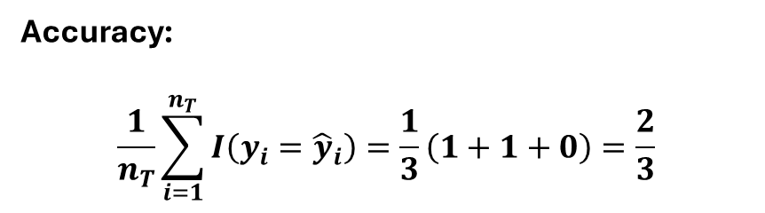
Evaluation metrics
How to compare the predicted classes to ground truth classes?
Predicted classes
Test data instance
Weather | Weekend? | Finished HW | Go Hiking?
Snow | Yes | No | Yes
Overcast | Yes | Yes | Yes
Snow | No | Yes | No
Weather | Weekend? | Finished HW | Go Hiking?
Snow | Yes | No | Yes
Overcast | Yes | Yes | Yes
Snow | No | Yes | Yes
Accuracy:
$$\frac{1}{n_{T}}\sum_{i=1}^{n_{T}}{I\left(y_{i}={\hat{y}}_{i}\right)=\frac{1}{3}\left(1+1+0\right)=\frac{2}{3}}$$

Slide 54
In class activity
Assuming that we have trained a classification model to predict fraudulent transactions, we used the model to predict the labels of a randomly selected test set of 10,000 transactions, which were not included in the training data. Out of these transactions, 100 were fraudulent, but the model predicted all 10,000 record as "non-fraudulent". What is the accuracy of the model based on this prediction?

Slide 55
Other Evaluation Metrics
How to compare the predicted classes to ground truth classes?
Predicted classes
Test data instance
Weather | Weekend? | Finished HW | Go Hiking?
Snow | Yes | No | Yes
Overcast | Yes | Yes | Yes
Snow | No | Yes | No
Weather | Weekend? | Finished HW | Go Hiking?
Snow | Yes | No | Yes
Overcast | Yes | Yes | Yes
Snow | No | Yes | Yes
Contingency-based measures
Precision, recall, F-measure
For Binary classification
TP, FN, FP, FN
Sensitivity, specificity

Slide 56
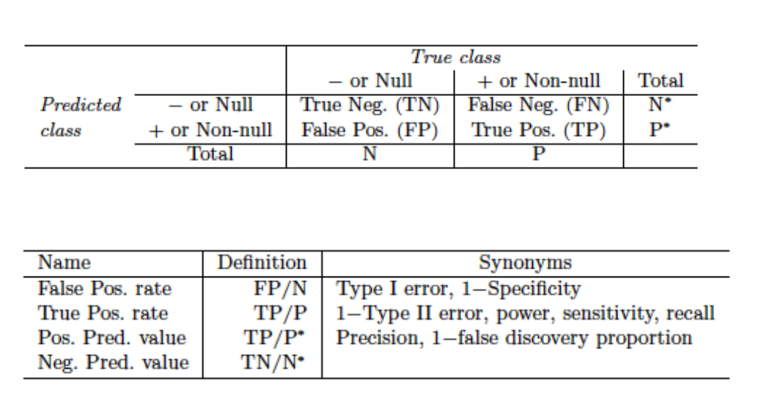
Summary of terminology

Slide 57

Bayes Theorem
Estimating prior probability $P\left(c_{i}\right)$
Let $D_{i}=\left\{x_{j}∈D | x_{j} has class y_{j}=c_{i}\right\}$
$\left|D\right|=n$, and $\left|D_{i}\right|=n_{i}$
$\hat{P}\left(c_{i} \right)=\frac{\left|D_{i}\right|}{\left|D\right|}=\frac{n_{i}}{n}$
There are two ways you can use to estimate the likelihood $P\left(x|c_{i}\right)$
Parametric approach
We make an assumption about the distribution of a particular class.
Ex: Each class is normally distributed.
Non-parametric approach

Slide 58

Bayes Theorem
Non-parametric approach
We make no assumptions about the probability distribution of a class.
We still want to compute $P\left(c_{i}|x\right)=\frac{P\left(x|c_{i}\right)⋅P\left(c_{i}\right)}{P\left(x\right)}$
We can still estimate the $P\left(c_{i}\right)$, just like we did earlier.
How do we calculate $P\left(c_{i}|x\right)$ without making any assumptions about the distribution of the class?
One approach is to use k-nearest neighbor density estimation.
This algorithm is quite simple.

Slide 59

Bayes Theorem
Non-parametric approach
For a given point we look at a radius $r$ hypersphere such that we include its k-nearest neighbor.
We can use any distance measurement for this radius, e.g., $L_{1}, L_{2}, …,L_{∞}.$
We can count the number of points in each class in this hypersphere.
We can use this information to calculate $P\left(c_{i}|x\right)$
$P\left(c_{i}|x\right)=\frac{\# of neighbors with class c_{i}}{k}$
This is called a lazy classifier
You can try a small value for $k$ and check the accuracy of the classification.
There is no way to find the best possible k value theoretically.
Surprisingly, this works very well on real-world datasets.

Slide 60

Bayes Theorem
Non-parametric approach
How can we tackle ties?
Simplest solution is to make $k$ an odd value (if there are only two classes)
For multi-class problem still, we could have this problem.
Use weighted voting
Instead of simply counting votes, assign higher weights to closer neighbors.
$w_{i}=\frac{1}{d_{i}}:d_{i} is the distance to the i^{th} neighbor$
Class with the highest total weight wins.
Random selection
If there is a tie, pick one of the tied class randomly.
Prioritize classes based on frequency
Requires prior knowledge of class distributions

Slide 61

Evaluation methods for classification
In the last lecture we looked at $Accuracy≔\frac{1}{n}\sum_{i=1}^{n}{I\left(y_{i}={\hat{y}}_{i}\right)}$
Basically, count the number of mismatches and sum them up, and take the arithmetic mean.
$ErrorRate=\frac{1}{n}\sum_{i=1}^{n}{I\left(y_{i}≠{\hat{y}}_{i}\right)}=1−Accuracy$
We can also look at the Precision, Recall and F-score of the output as well which are contingency table-based methods.
$prec_{i}=\frac{n_{ii}}{m_{i}}$ $recall_{i}=\frac{n_{ii}}{n_{i}}$ $F_{i}=\frac{2⋅prec_{i}⋅recall_{i}}{prec_{i}+recall_{i}}$ $F=\frac{1}{k}\sum_{i=1}^{k}{F_{i}}$

Slide 62

Binary classification
When you only have two classes
We call the class $c_{1}$ as the positive class and class $c_{2}$ as the negative class.
What is the size of the confusion matrix (a.k.a contingency table)?
$True Positives (TP)$: the number of points that the classifier correctly predicts as positive
$TP=n_{11}=\left|\left\{x_{i} | {\hat{y}}_{i}=y_{i}=c_{1}\right\}\right|$
$False Positives (FP)$: the number of points classifier incorrectly predicts as positives where they are negatives.
$FP=n_{12}=\left|\left\{x_{i}|{\hat{y}}_{i}=c_{1} and y_{i}=c_{2}\right\}\right|$
$False Negatives:$ the number of points incorrectly predicted as negatives where they are positives:
$FN=n_{21}=\left|\left\{x_{i} |{\hat{y}}_{i}=c_{2} and y_{i}=c_{1}\right\}\right|$
$True Negatives:$ the number of points correctly predicted as negatives
$TN=n_{22}=\left|\left\{x_{i} |{\hat{y}}_{i}=y_{i}=c_{2}\right\}\right|$

Slide 63



 | True Class
Predicted Class | Positives ($c_{1}$) | Negatives ($c_{2}$)
Positives ($c_{1}$) | True Positives (TP) | False Positives (FP)
Negatives ($c_{2}$) | False Negatives (FN) | True Negatives (TN)
Contingency table/Confusion matrix for Two classes
$$Error Rate= \frac{FP+FN}{n}$$
$$Accuracy =\frac{TP+TN}{n}$$
These are global measures of classifier performance.

Slide 64


 | True Class
Predicted Class | Positives ($c_{1}$) | Negatives ($c_{2}$)
Positives ($c_{1}$) | True Positives (TP) | False Positives (FP)
Negatives ($c_{2}$) | False Negatives (FN) | True Negatives (TN)
Contingency table/Confusion matrix for Two classes
$$prec_{P} =\frac{TP}{TP+FP}=\frac{TP}{m_{1}}$$
$$prec_{N} =\frac{TN}{FN+TN}=\frac{TN}{m_{2}}$$
These are class specific Precision values

Slide 65




 | True Class
Predicted Class | Positives ($c_{1}$) | Negatives ($c_{2}$)
Positives ($c_{1}$) | True Positives (TP) | False Positives (FP)
Negatives ($c_{2}$) | False Negatives (FN) | True Negatives (TN)
Contingency table/Confusion matrix for Two classes
Sensitivity is called True Positive Rate
$$TPR=recall_{P}=\frac{TP}{TP+FN}=\frac{TP}{n_{1}}$$
Specificity is called True Negative Rate
$$TNR=recall_{N}=\frac{TN}{FP+TN}=\frac{TP}{n_{2}}$$
False Negative Rate
$$FNR=\frac{FN}{TP+FN}=\frac{FN}{n_{2}}=1−sensitivity$$
False Positive Rate
$$FPR=\frac{FP}{FP+TN}=\frac{FP}{n_{2}}=1−sepecificity$$

Slide 66

Classifier Evaluation
We can also evaluate a classifier $M$ using some performance measure $θ$.
We use something called $K−Fold cross validation$

Slide 67

K-fold cross validation
Idea
We divide the dataset $D$ into $K$ equal sized parts, called folds, namely $D_{1}, D_{2},…, D_{k}$.
Each fold $D_{i}$ is treated as a testing set, with remaining folds comprising the training set $D∖D_{i}= \bigcup_{j≠i}{D_{j}}$
After training the dataset, we asses the performance of the $D_{i}$ testing set and retrieve $θ_{i}$
Then we calculate the ${\hat{μ}}_{θ}=E\left[θ\right]=\frac{1}{K}\sum_{i=1}^{K}{θ_{i}}$ and variance ${\hat{σ}}_{θ}^{2}=\frac{1}{K}\sum_{i=1}^{K}{{\left(θ_{i}−{\hat{μ}}_{θ}\right)}^{2}}$

